Slide 1


EnlightenDS:
Advanced Technologies for Skill Enhancement and Talent Recognition in Children with Down Syndrome
Presented by:
24-25J-228

Slide 2
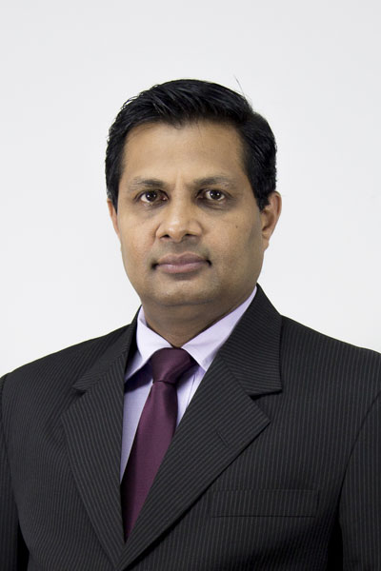
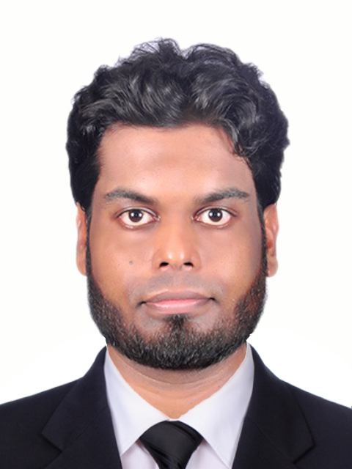
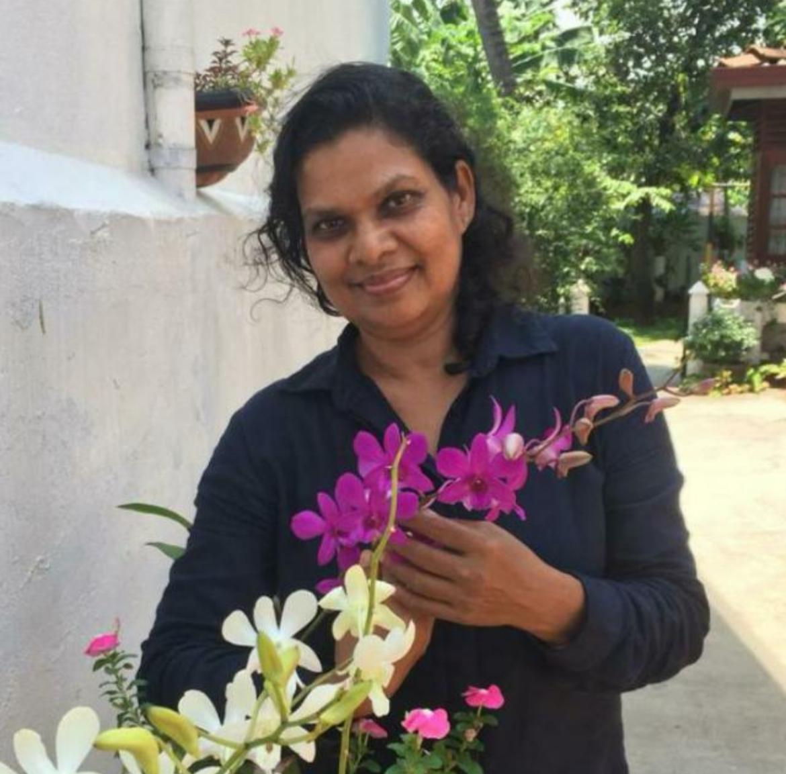


Supervisory Details
Prof. Samantha Thelijjagoda
Dr. Junius Anjana
Dr. Kamalani Wanigasinghe
Doctor at Senehasa Research Centre
Supervisor
Co-Supervisor
External Supervisor
IT21293030 Jayasuriya S.H. 25J-228

Slide 3
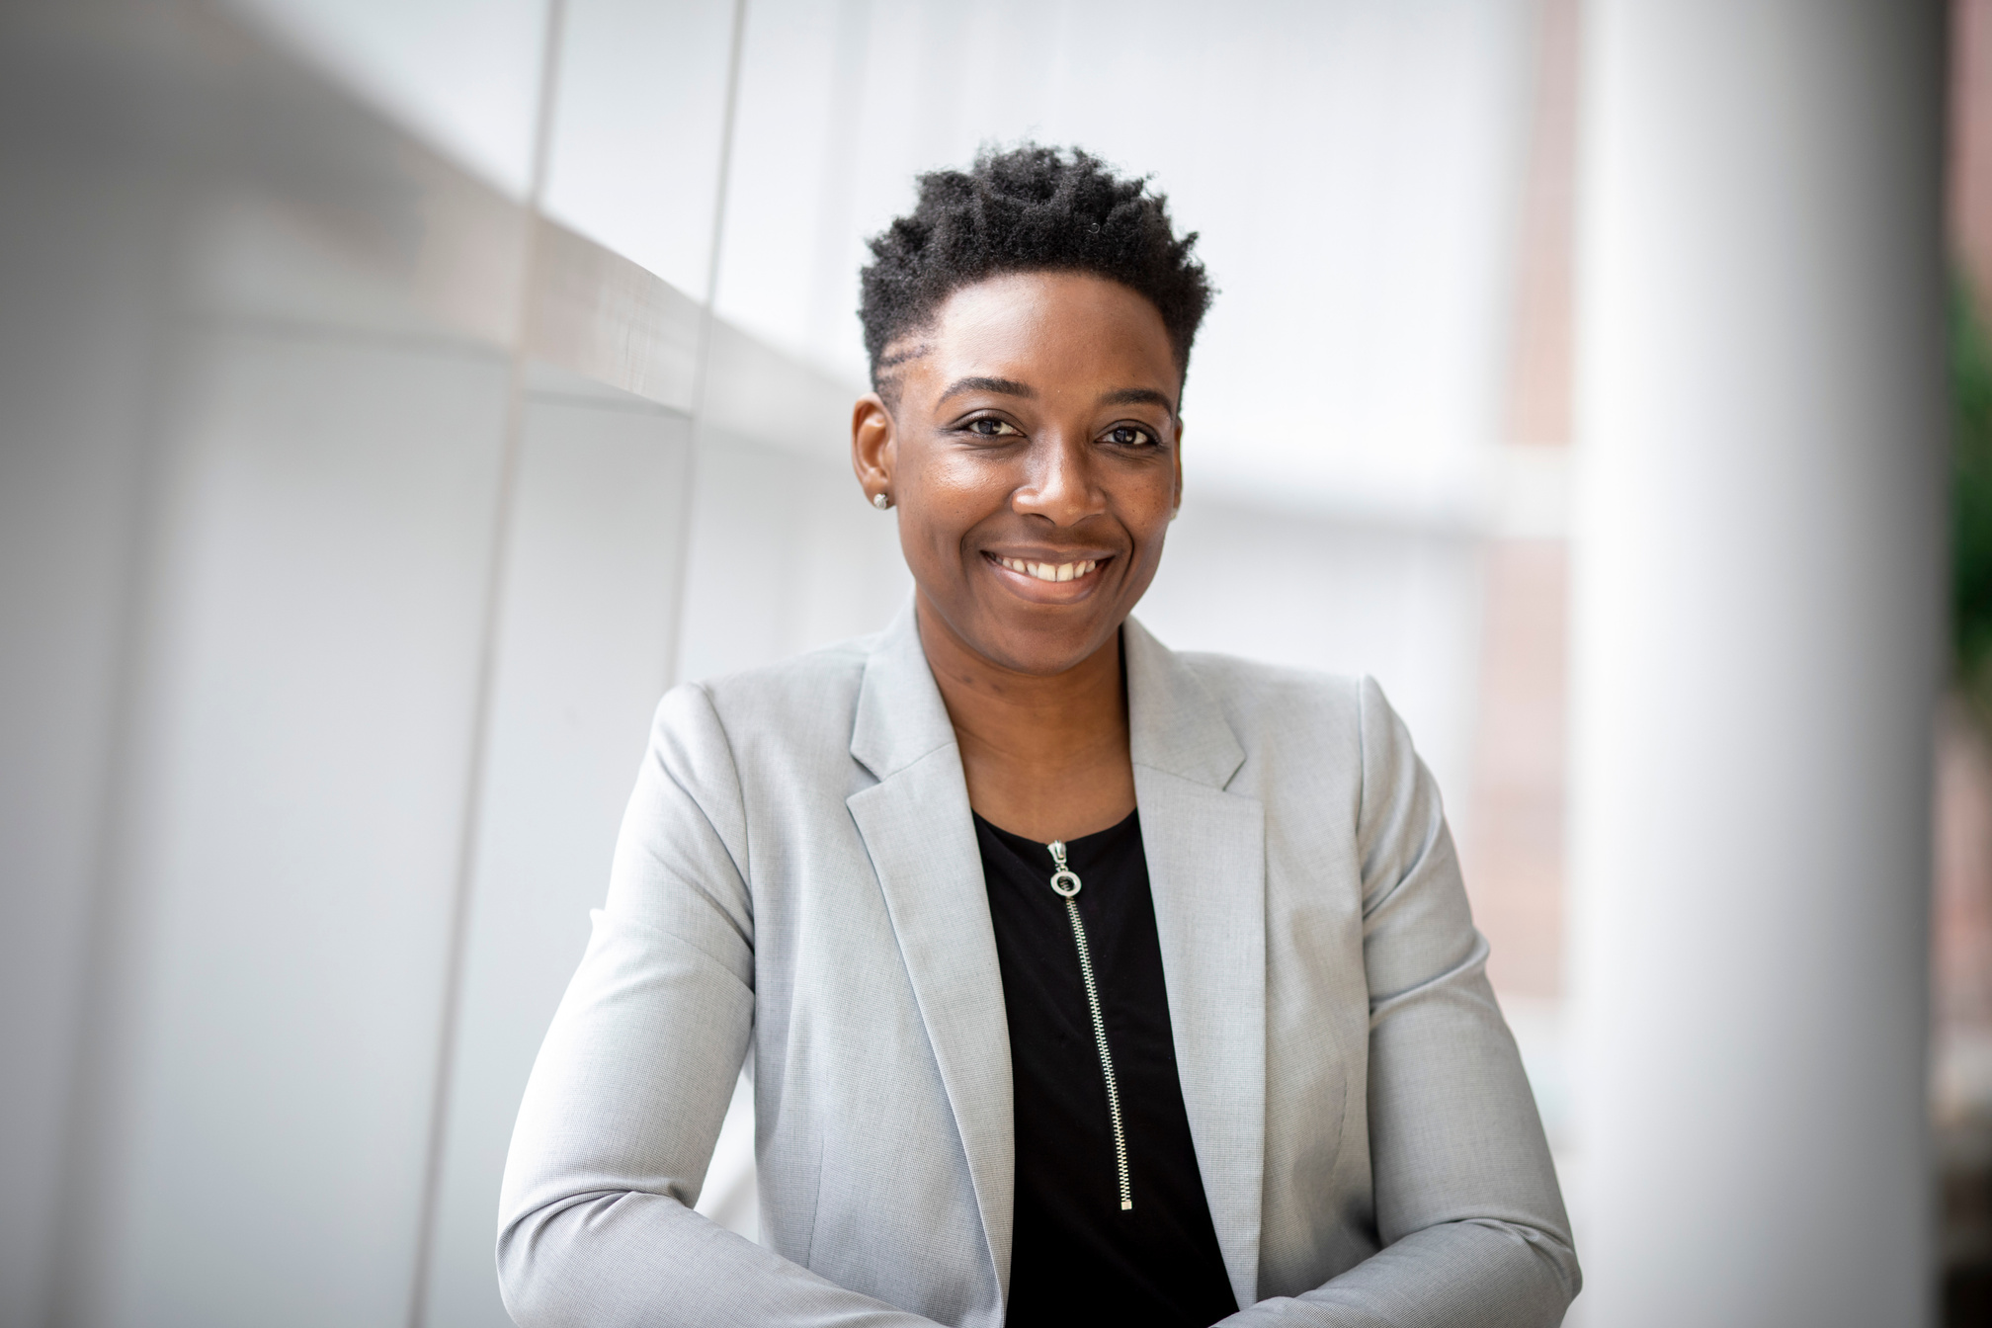
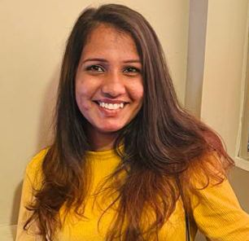
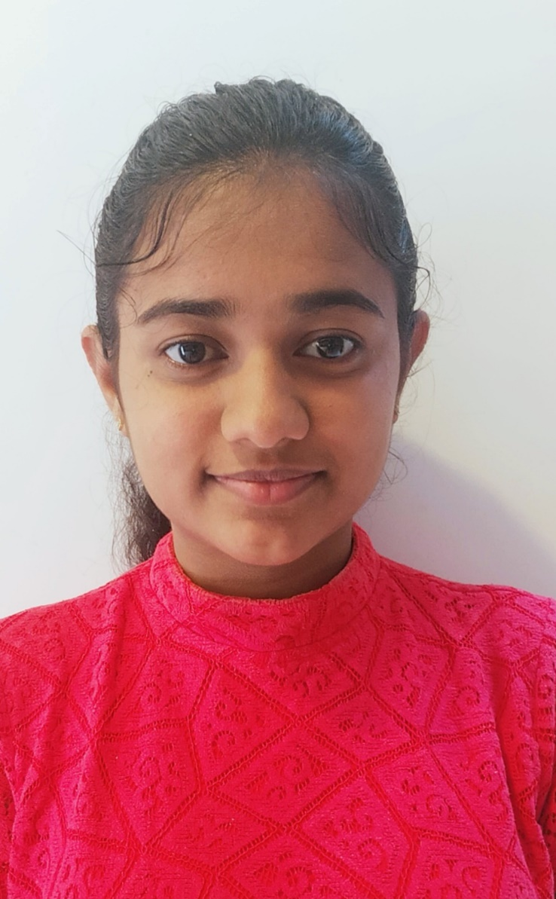
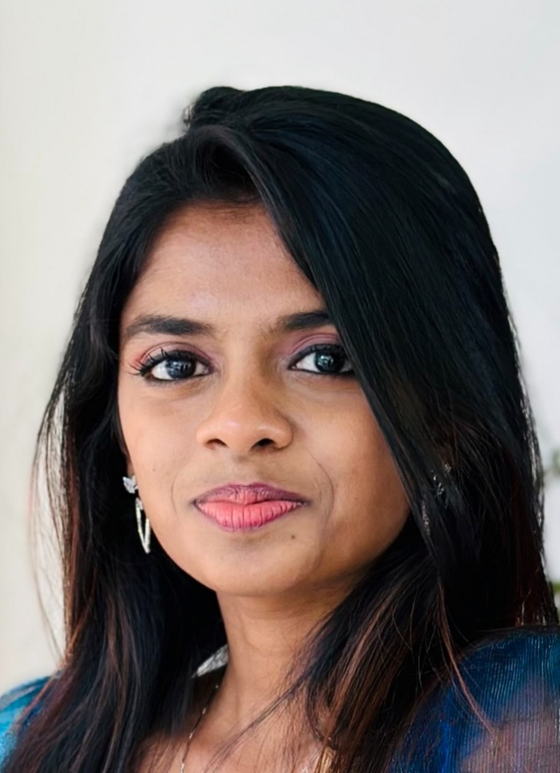
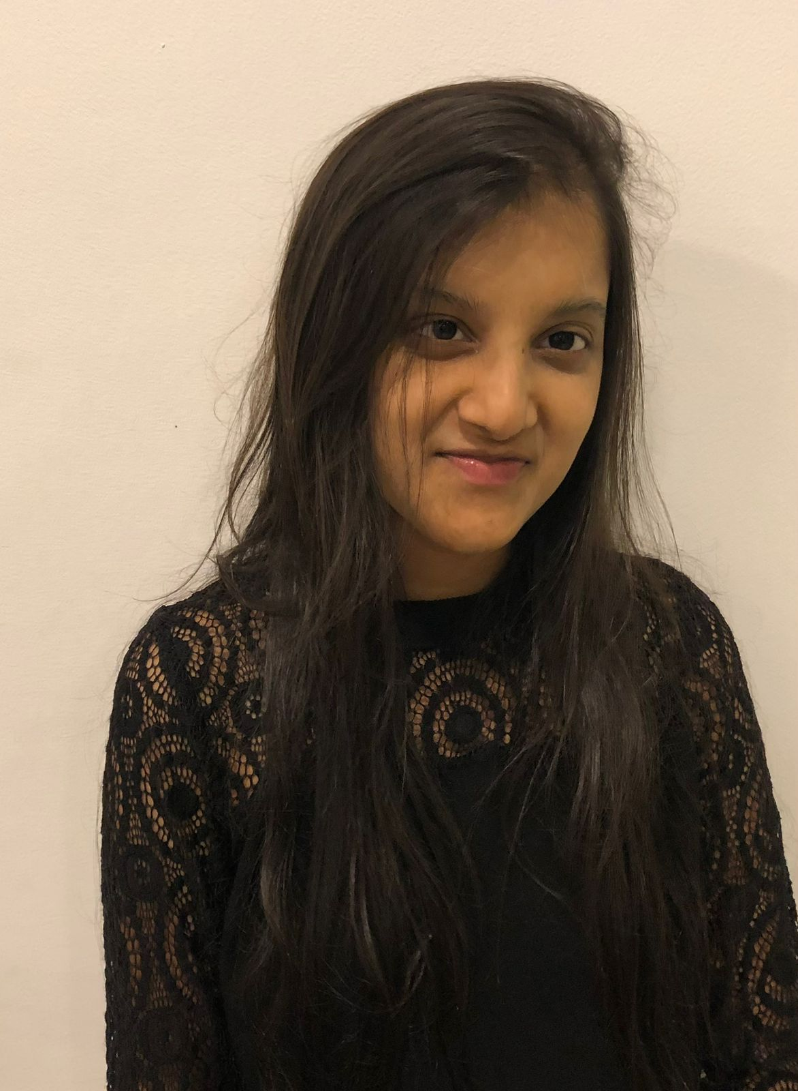
Team Members
Kumarasinghe D.P Jayasuriya S.H
Semini B.V.S Methsahani K.K.S.P
IT21296314
IT21293030
IT21342394
IT21292972
IT21293030 Jayasuriya S.H. 25J-228

Slide 4
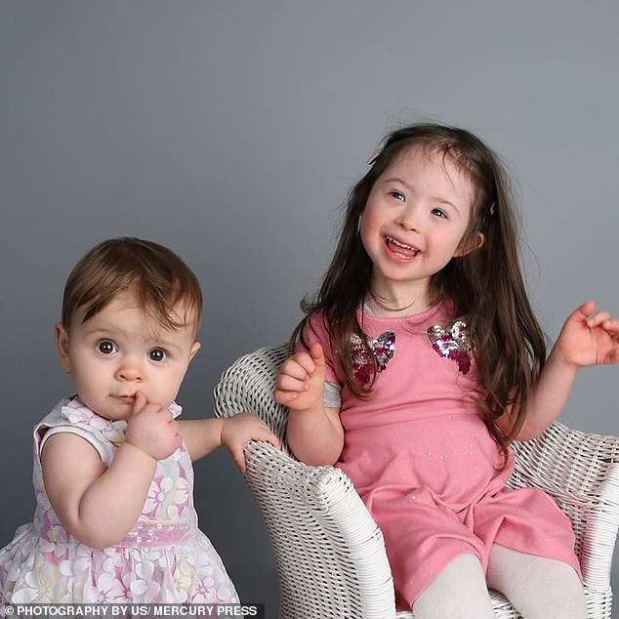
Background
01
Genetic disorder caused by an extra chromosome 21 [1]
02
Affects approximately 1 in 700 births globally [2]
03
Leads to developmental delays and intellectual disabilities and requires tailored interventions for cognitive and personal growth [3]
04
Designed for children with Down syndrome aged 5-15.

Slide 5

Research Question
How can we assess the detection of Down syndrome in children?
How can we assess the cognitive levels of children with Down syndrome?
What innovative techniques can be employed to improve pronunciation skills in Down syndrome children?
How adaptive learning environments improve mathematical skills?
How can we identify and nurture artistic talents in children with Down syndrome?
How can we check if our educational system is helping kids learn and grow?

Slide 6


01
Asess the detection of down syndrome
Main Objective
02
Improve pronunciation skills
Create a system that supports the detection, cognitive linguistic, mathematical and creative development of children with Down syndrome, aged 5-15 through personalized and adaptive educational interventions.
03
Enhance mathematical skills
03
04
Identify and nurture artistic talents
04
05
Provide guidance to parents and educators
05
06
Develop metrics to assess the impact
06

Slide 7
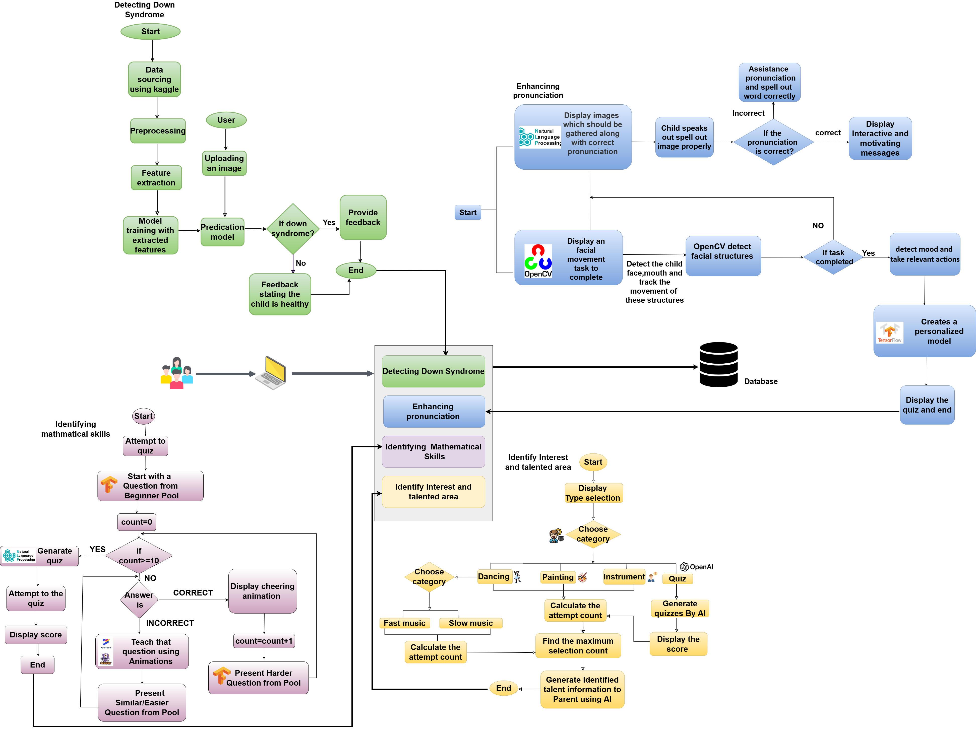
System Diagram

Slide 8
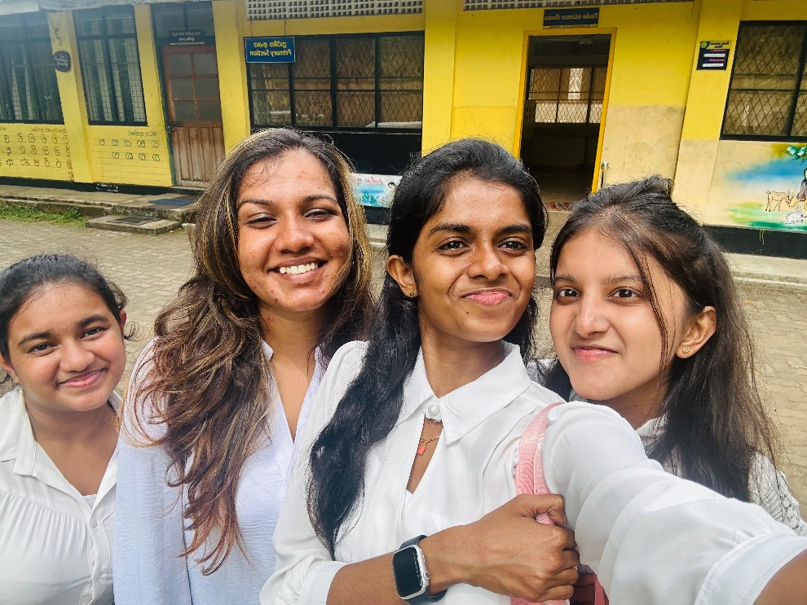

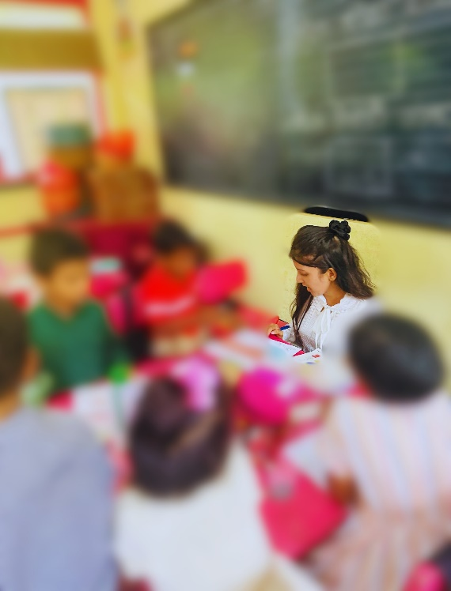
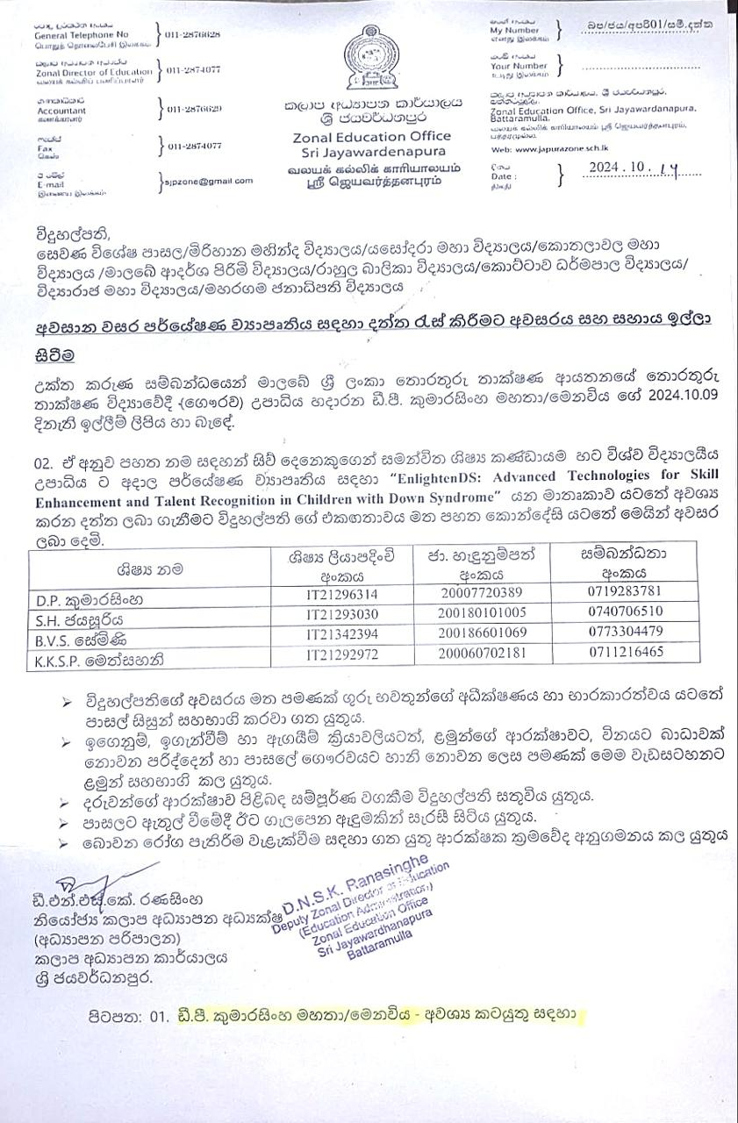
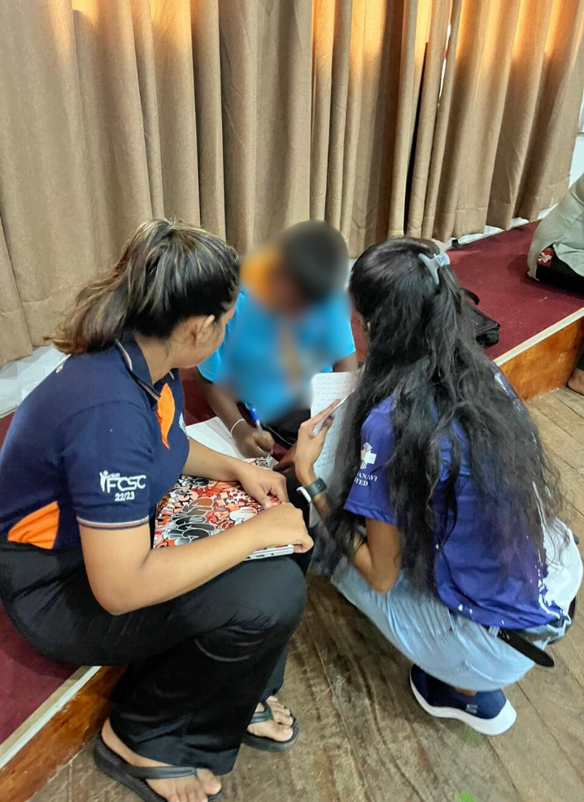
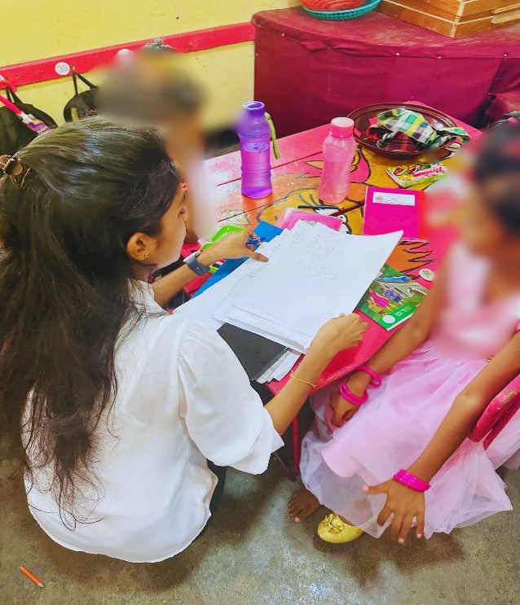
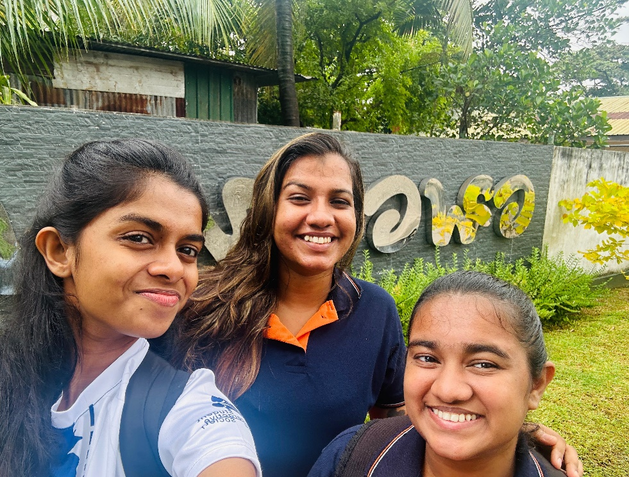
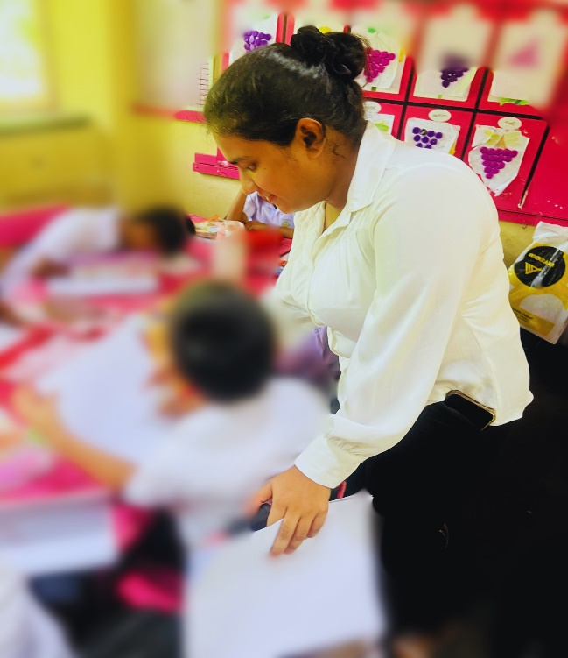
Data Collection

Slide 9
Risk Mitigation
Risk | Risk Mitigation
Privacy and ethical concerns when collecting and storing sensitive data about children | Completed the ethical clearance form, obtained permission from the zonal education office and ensured anonymization of data to protect privacy
Some parents hesitated to give consent for their children to participate | Hold sessions to inform parents about the project’s purpose, benefits and data privacy measures
Children may lose interest in using the tools or platforms over time | Decided to add interactive, gamified features and variety to maintain engagement
Resistance or lack of interest from educators, therapists and parents | Create awareness campaigns highlighting the benefits of the proposed solutions.

Slide 10



Commercialization Plan
Basic Plan
Free
Premium Plan
$10 /month
School Plan
$30 /month
Cognitive level assessment tools.
Basic communication improvement activities.
Limited personalized quizzes for math.
Painting and piano platforms.
Basic summary reports
All features from the Basic Plan.
Full access to personalized quizzes
Emotion-based activities and mood detection.
Advanced summary
Full access to all features from Premium package
Up to 40 students

Slide 11
Budget
Component | Amount(LKR)
Travelling cost | 10000
Server & Hosting charges | 25000
Internet Charges | 15000
Total | 50000

Slide 12
References
[1] (“Down syndrome: Causes, characteristics, is it genetic, and more.” Accessed: Aug. 11, 2024. [Online]. Available: https://www.medicalnewstoday.com/articles/145554 )
[2] (“ Young children’s spontaneous utterances of mental terms and the accuracy of their memory behaviors: a different methodological approach - Cherney - 2003 - Infant and Child Development - Wiley Online Library.” Accessed: Aug. 11, 2024. [Online]. Available: https://onlinelibrary.wiley.com/doi/10.1002/icd.267 )
[3] (“Frontal electroencephalogram asymmetry during affective processing in children with Down syndrome: a pilot study - Conrad - 2007 - Journal of Intellectual Disability Research - Wiley Online Library.” Accessed: Aug. 11, 2024. [Online]. Available: https://onlinelibrary.wiley.com/doi/10.1111/j.1365-2788.2007.01010.x )
IT21296314 | Kumarasinghe D.P. | 24-25J-228

Slide 13

IT21296314 | Kumarasinghe D.P.
Specialization : Information Technology
Assessing the detection of down syndrome
IT21296314 | Kumarasinghe D.P. | 24-25J-228
IT21293030 Jayasuriya S.H. 25J-228

Slide 14
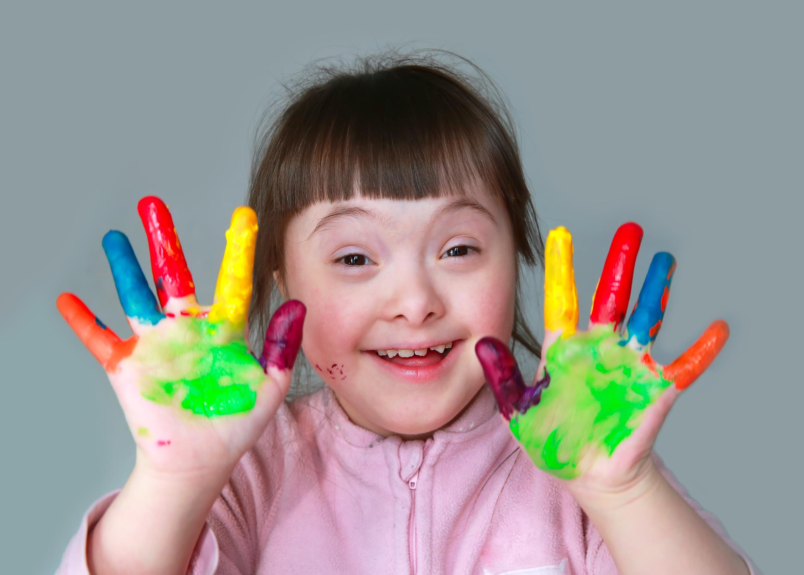
Background
Progression of thinking, learning, memory, and problem-solving
01
02
Hard for them to connect with others, perform well in school and build confidence
03
Typically involves mild to moderate intellectual disabilities [4]
04
Delays in speech, communication, memory issues, attention deficits, and difficulty with abstract thinking [5]
IT21296314 | Kumarasinghe D.P. | 24-25J-228

Slide 15
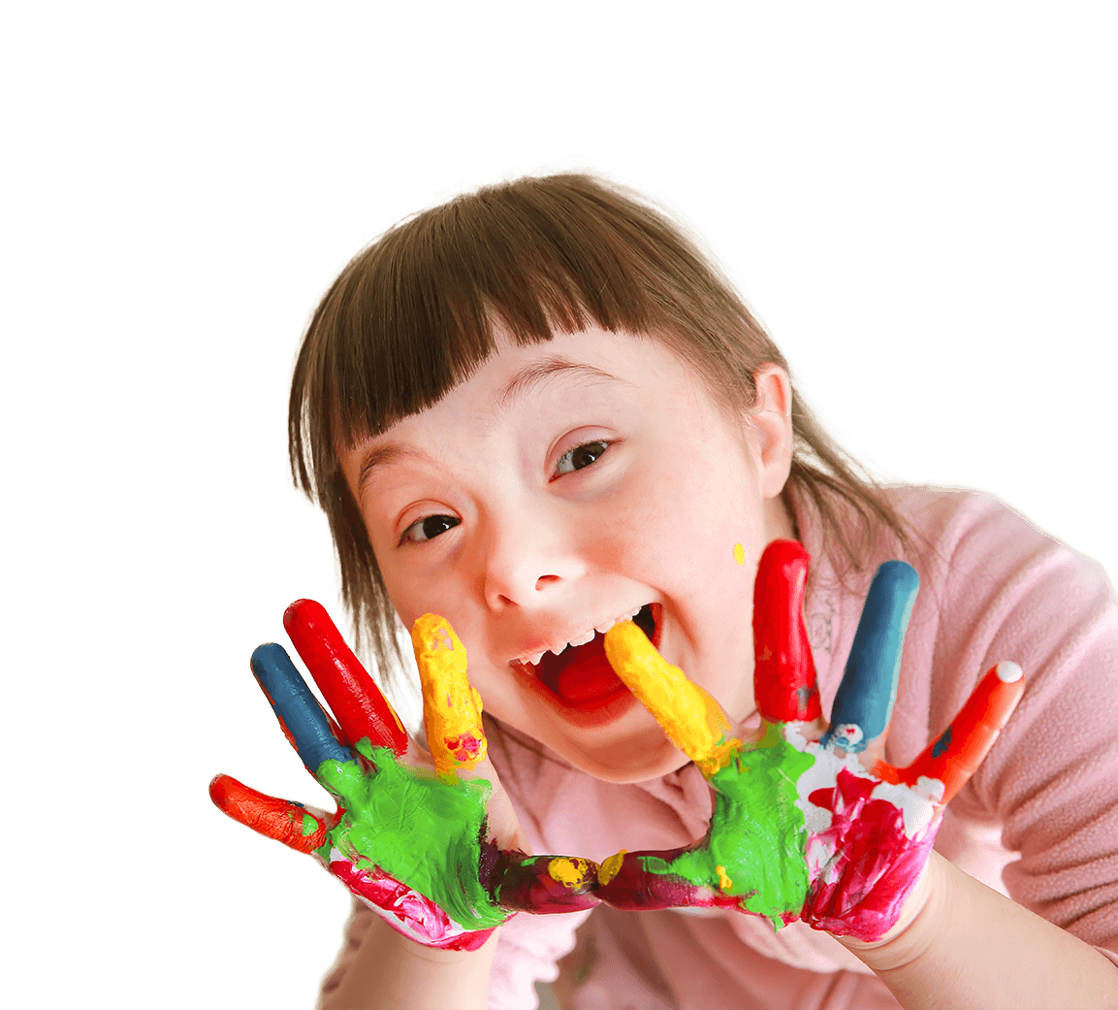
05
Affects education, social skills, and quality of life
06
Crucial for effective educational strategies
07
To assess detection of down syndrome accurately, ensuring proper support for children with Down syndrome to succeed academically and socially [6]
IT21296314 | Kumarasinghe D.P. | 24-25J-228

Slide 16


Research Gap
Features
[7]
[8]
[9]
[10]
Used a test to asses the cognitive development
Used image processing
Used CNN
Web based application
Gender not biased
[7] July 2024,” An Android Augmented Reality Application to Improve Cognitive Skills in Color Recognition for Down Syndrome children
[8] December 2023, “BENDI: Improving Cognitive Assessments in Toddlers and Children with Down Syndrome Using Stealth Assessment
[9] November 2018, “Motor and cognitive development of children with Down syndrome: The effect of acquisition of walking skills on their cognitive and language abilities
[10] February 2020, “Cognitive Impairments in Children with Down Syndrome
IT21296314 | Kumarasinghe D.P. | 24-25J-228

Slide 17
Research Question
How can early detection of down syndrome improve developmental outcomes considering the unique challenges children face in cognitive and social development?
IT21296314 | Kumarasinghe D.P. | 24-25J-228

Slide 18
01
Gather a diverse dataset of
Images from
children with Down syndrome.
Specific Objective
Apply preprocessing techniques to prepare images for analysis
02
To assess the detection of Down syndrome in children aged 5-15 years
Utilize convolutional neural networks to extract
key features from the images
03
03
Train the CNN using labeled data derived from facial symptoms to predict the probability of Down syndrome
04
04
Compare CNN predictions with traditional diagnostic methods for assessing detection reliability
05
05
06
Develop a user-friendly interface for uploading images and receiving feedback.
06
IT21296314 | Kumarasinghe D.P. | 24-25J-228

Slide 19
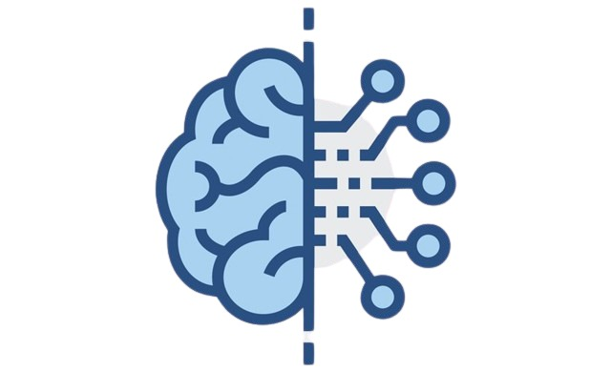




Technologies
React
Convolutional Neural Network (CNN)
JavaScript libraries
TensorFlow
Phyton
IT21296314 | Kumarasinghe D.P. | 24-25J-228

Slide 20
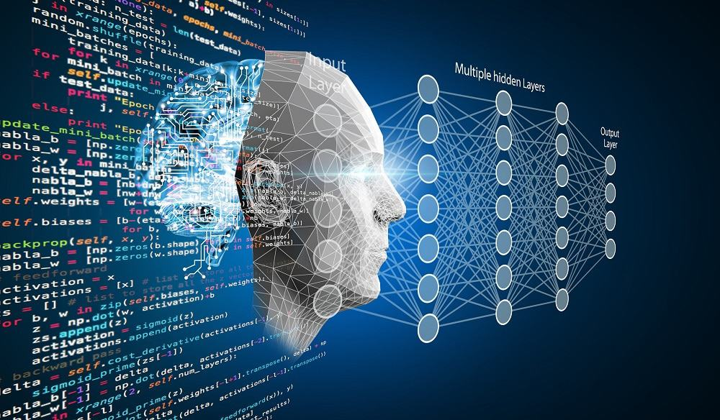
Key Pillars
Google Colab
Convolutional Neural Network (CNN)
Machine
Learning
Image
Processing
IT21296314 | Kumarasinghe D.P. | 24-25J-228

Slide 21
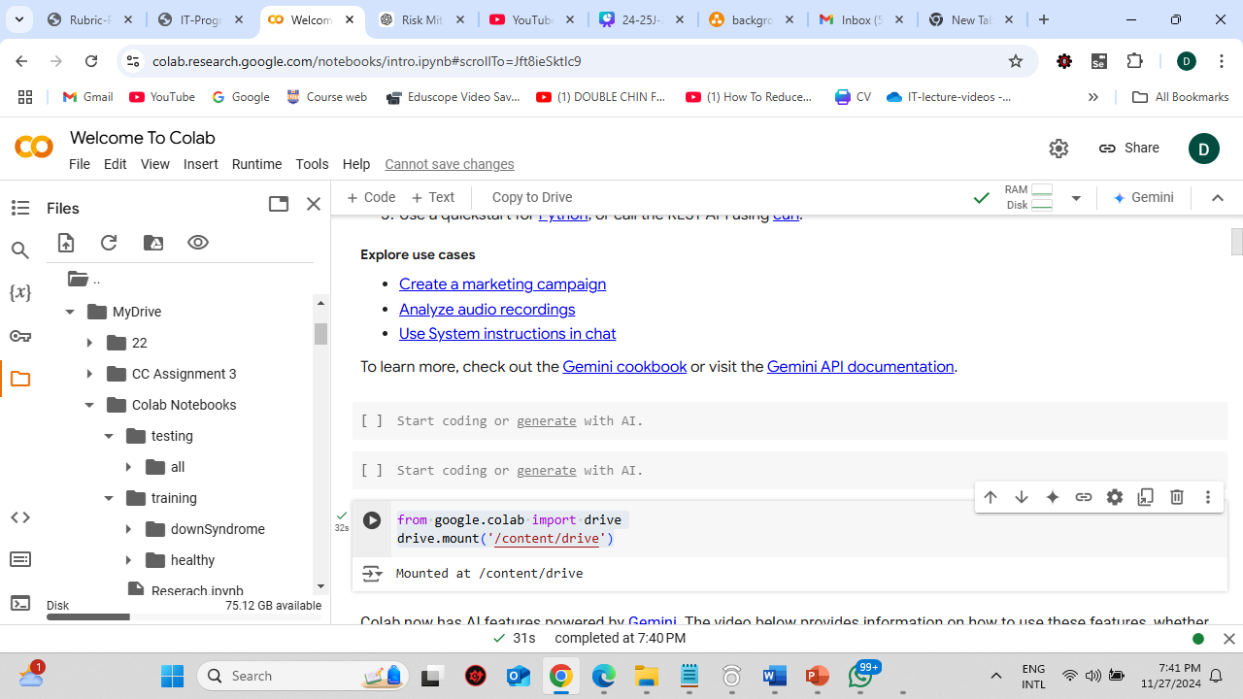
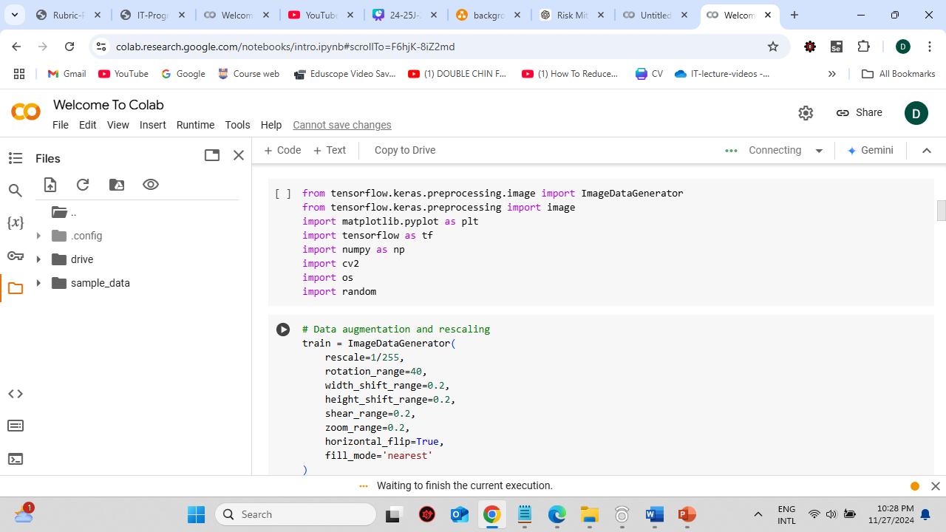
Proof of Concept
Training & Testing datasets are stored in the google colab and model training starts
IT21296314 | Kumarasinghe D.P. | 24-25J-228

Slide 22
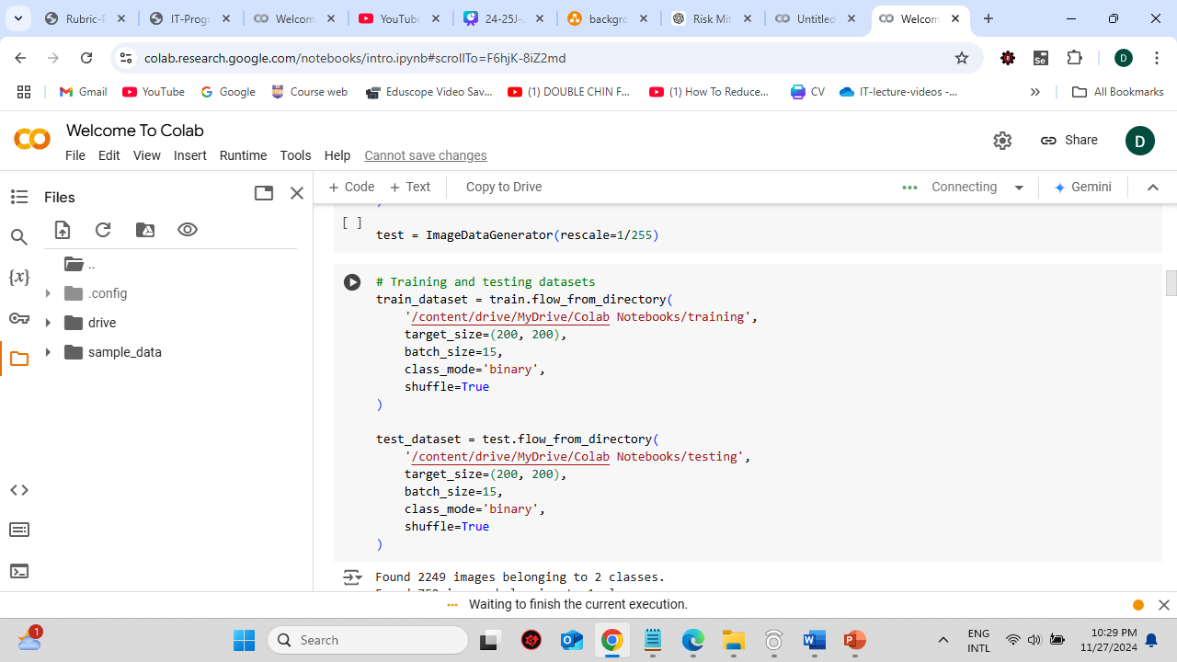
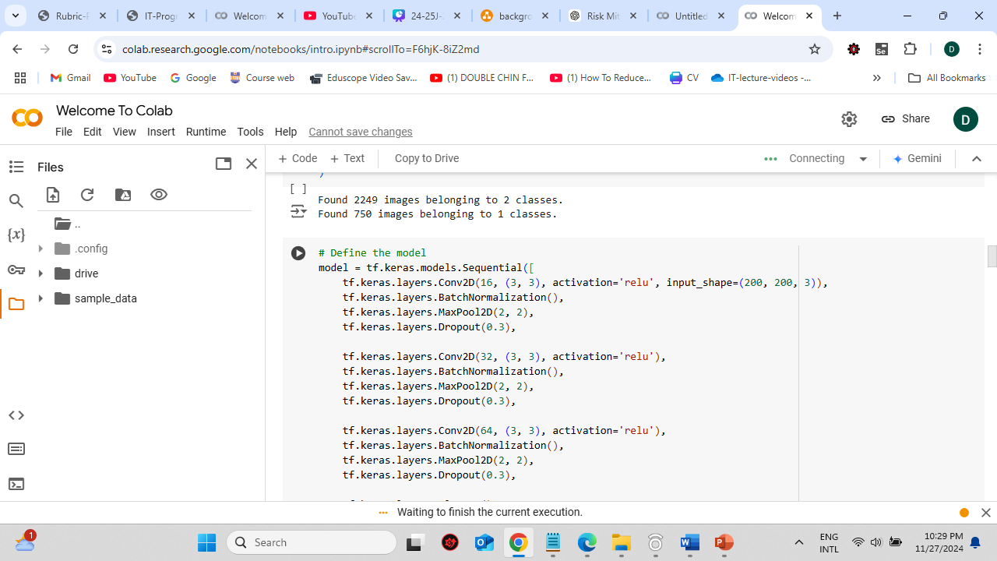
Proof of Concept
Creating Training and testing datasets and defined the model
IT21296314 | Kumarasinghe D.P. | 24-25J-228

Slide 23
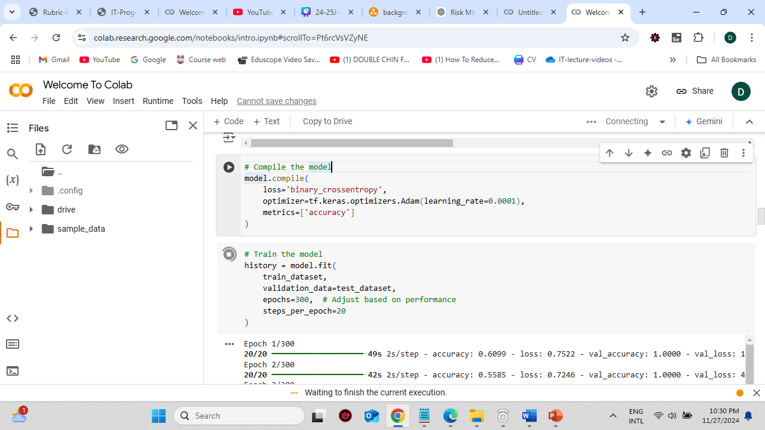
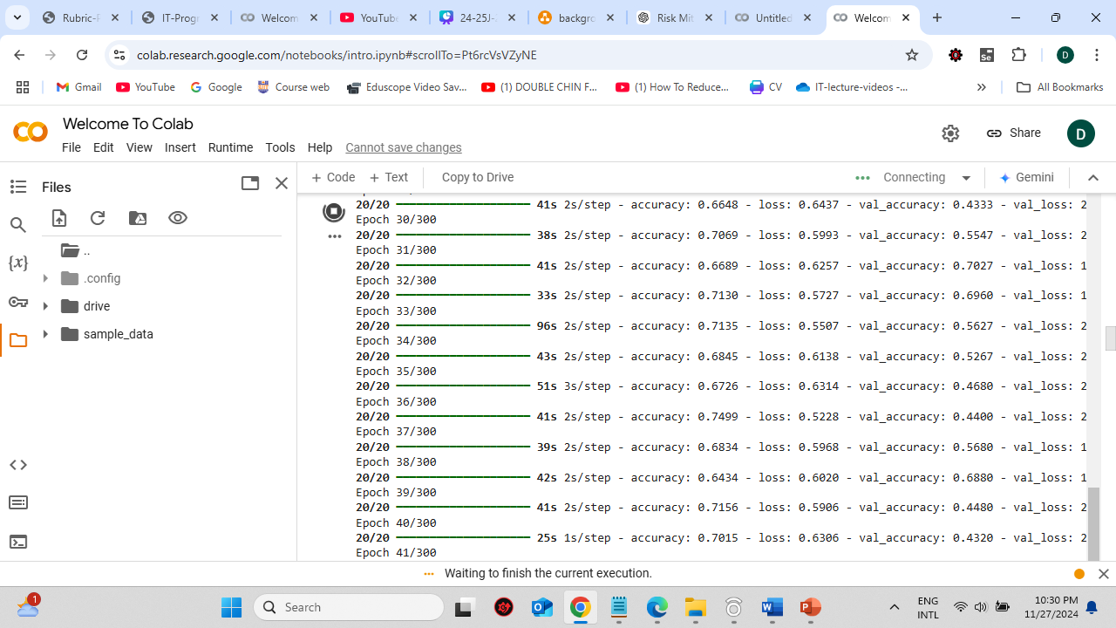
Proof of Concept
Compiled & trained the model
IT21296314 | Kumarasinghe D.P. | 24-25J-228

Slide 24
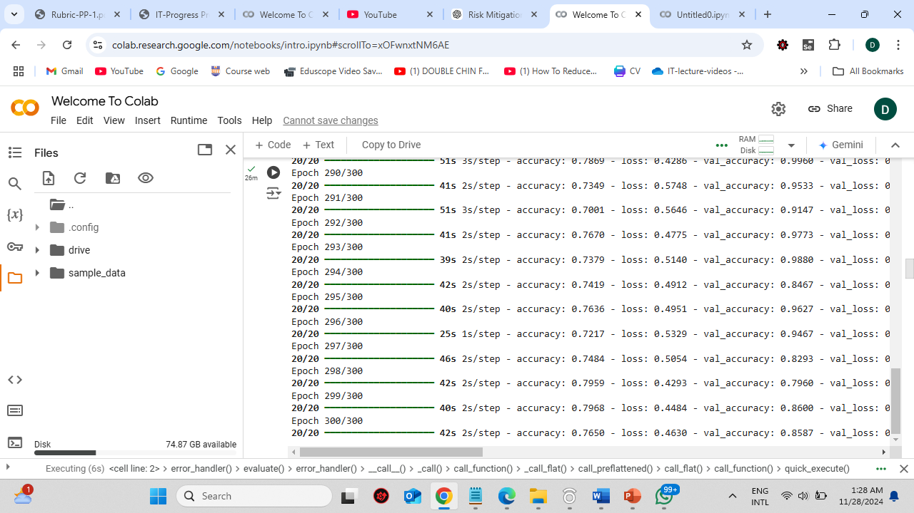
Proof of Concept
Completion of training the model
IT21296314 | Kumarasinghe D.P. | 24-25J-228

Slide 25
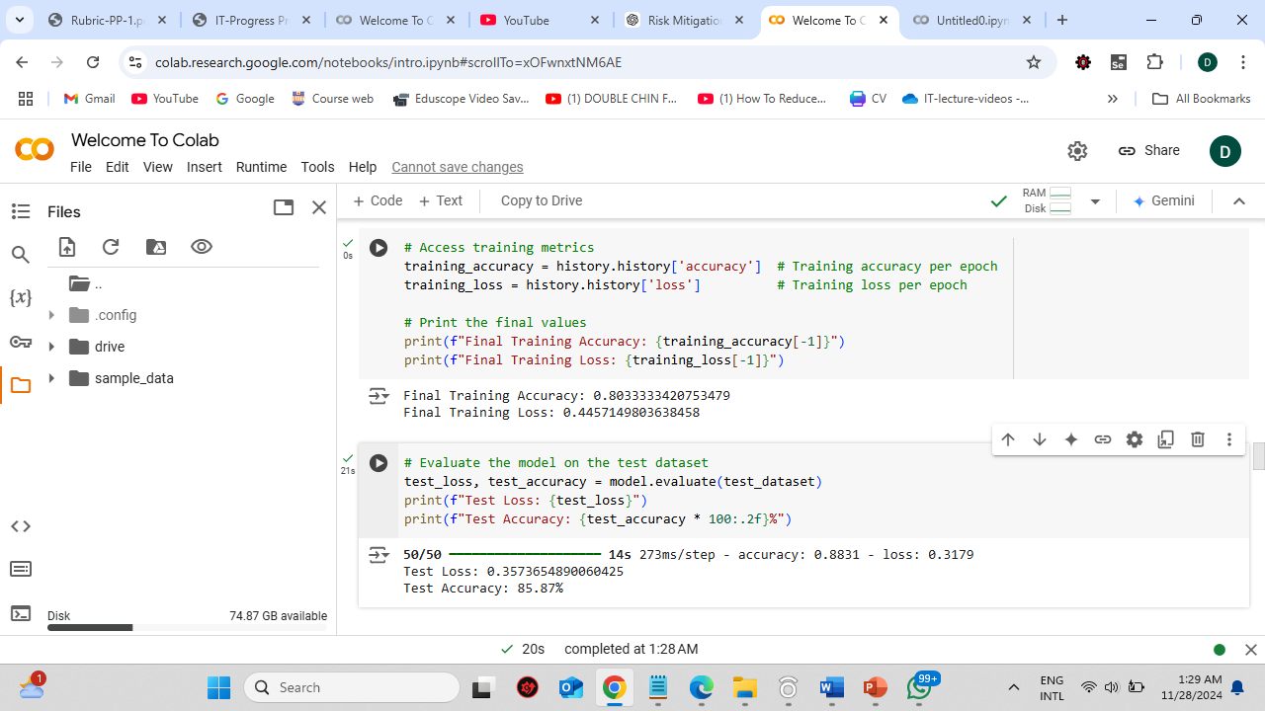
Proof of Concept
Training & Testing datasets accuracy
IT21296314 | Kumarasinghe D.P. | 24-25J-228

Slide 26
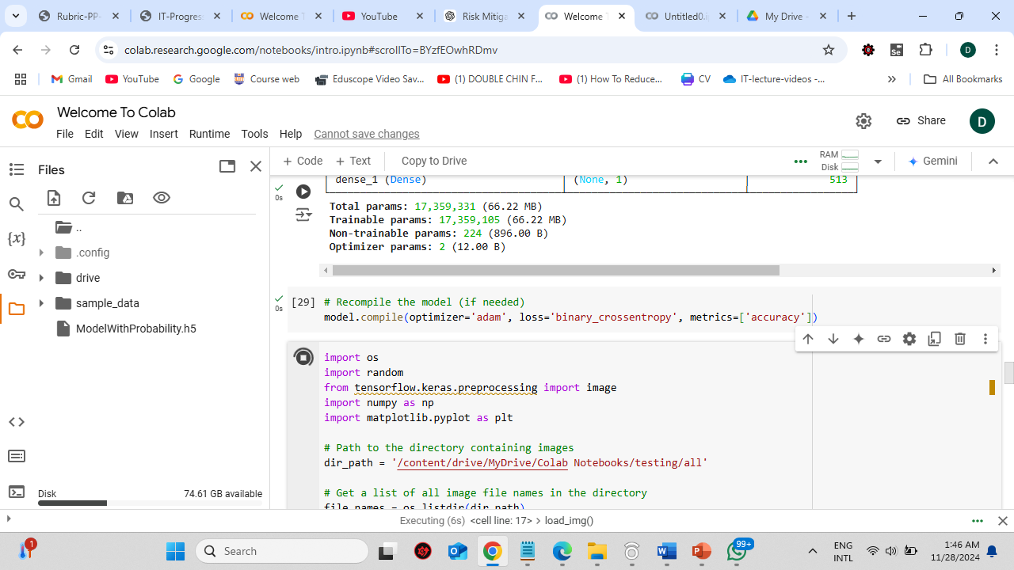
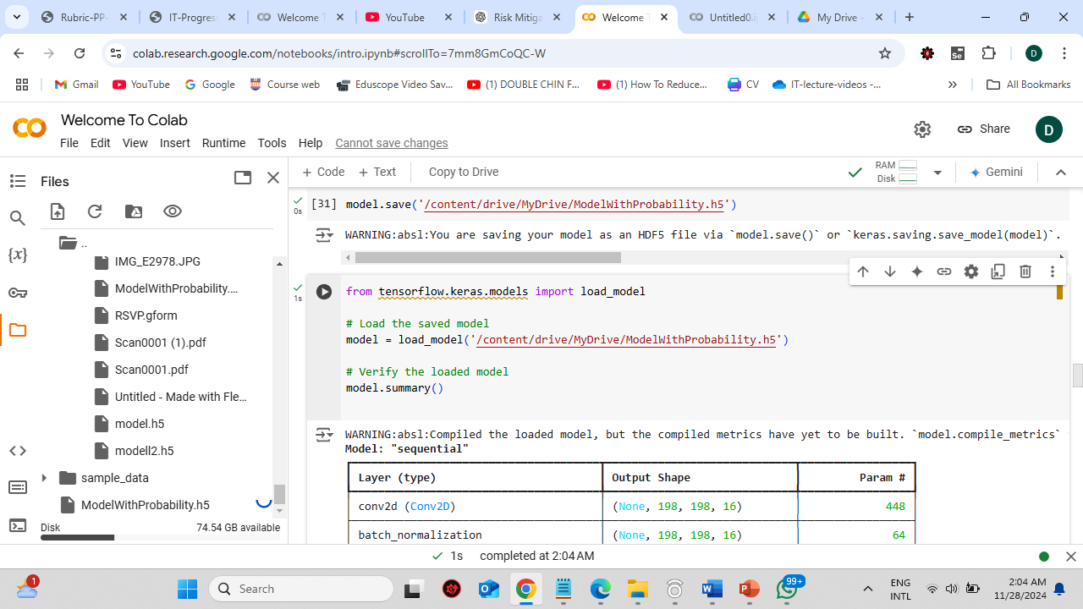
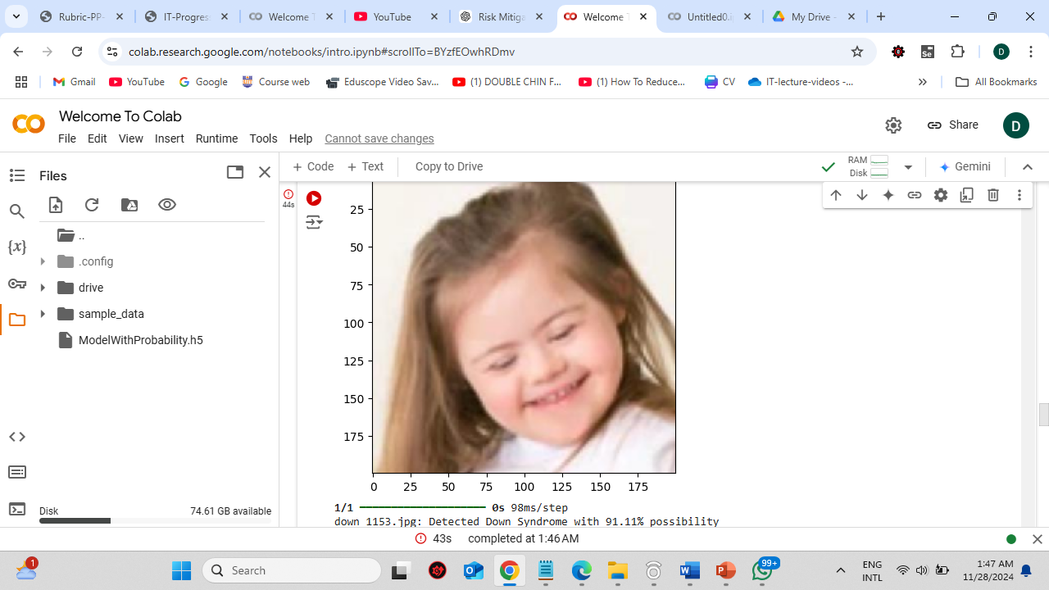
Proof of Concept
Saved the trained model and loaded it back
IT21296314 | Kumarasinghe D.P. | 24-25J-228

Slide 27
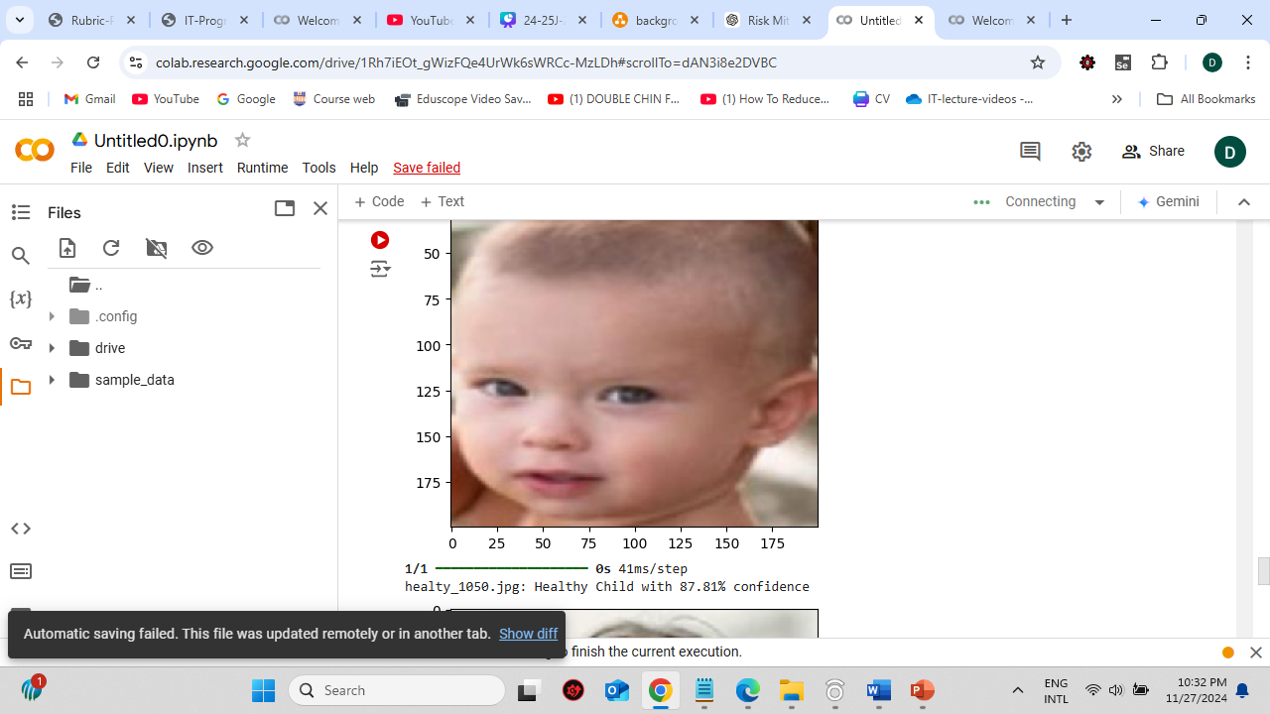
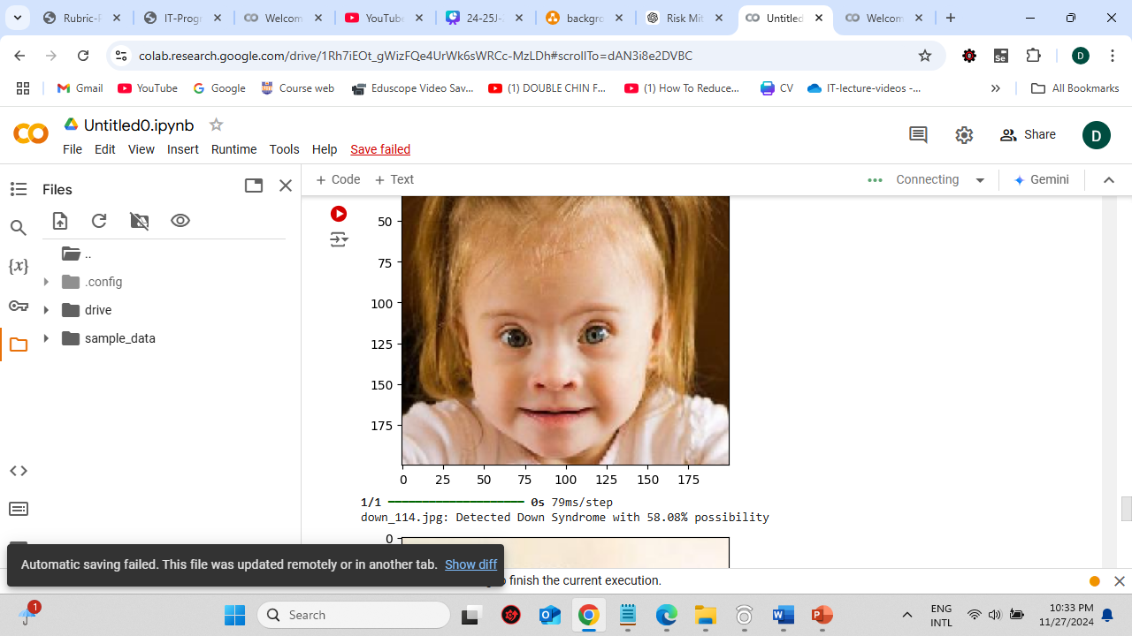
Proof of Concept
Test the model once its trained
IT21296314 | Kumarasinghe D.P. | 24-25J-228

Slide 28


Completion
Gathered a diverse dataset of images from children with Down syndrome
0
Trained the model
60%
Applied preprocessing techniques to prepare images for analysis
Trained the CNN to predict the probability of a child having down syndrome
IT21296314 | Kumarasinghe D.P. | 24-25J-228

Slide 29
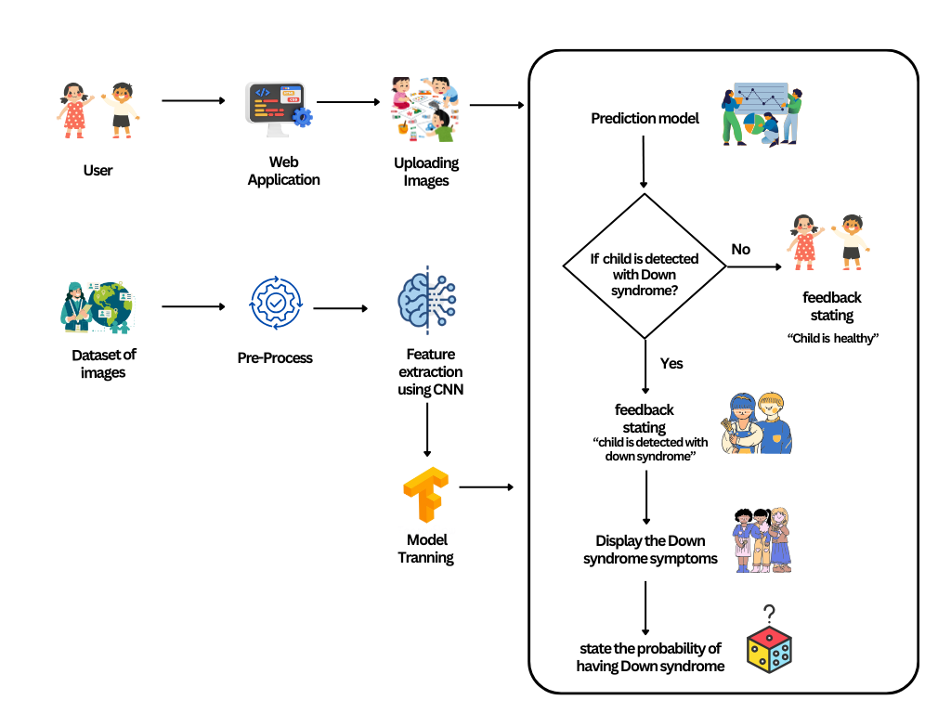
System Diagram
IT21296314 | Kumarasinghe D.P. | 24-25J-228

Slide 30


Functional & Non-functional Requirements
Functional Requirements
Non-Functional Requirements
Enable users to upload images
Ability to assess whether the child is having down syndrome or not
Ability to extract features using CNN
Ability to automatically preprocess uploaded images
Generate a possibility of having down syndrome based from the extracted features
Availability
Reliability
User friendly
High performance
IT21296314 | Kumarasinghe D.P. | 24-25J-228

Slide 31
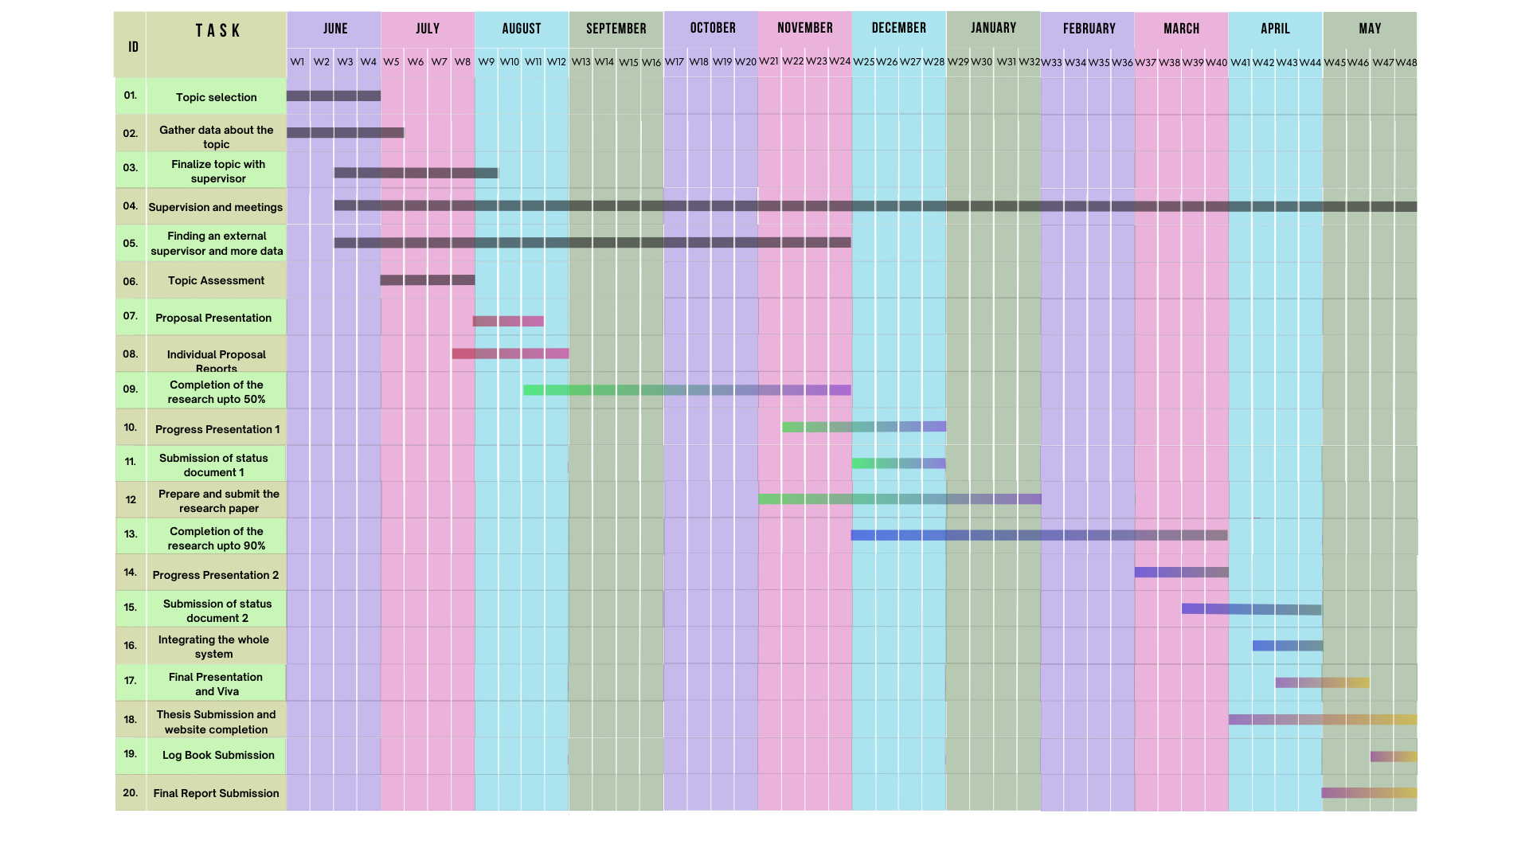
Gantt Chart
IT21293030 Jayasuriya S.H. 25J-228
IT21296314 | Kumarasinghe D.P. | 24-25J-228

Slide 32
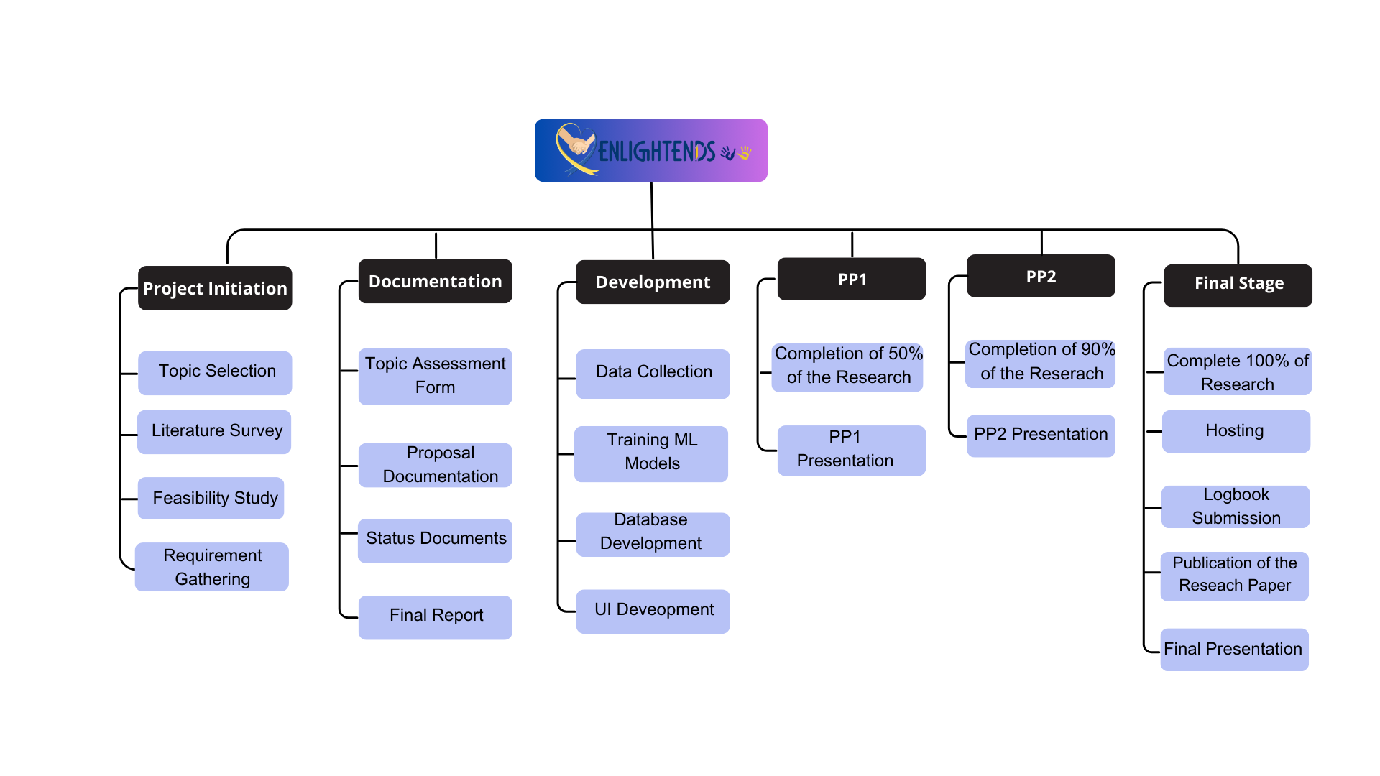
Work Breakdown Chart
IT21293030 Jayasuriya S.H. 25J-228
IT21296314 | Kumarasinghe D.P. | 24-25J-228

Slide 33
References
[4] S. Lanfranchi, O. Jerman, E. Dal Pont, A. Alberti, and R. Vianello, “Executive function in adolescents with Down Syndrome,” Journal of Intellectual Disability Research, vol. 54, no. 4, pp. 308–319, 2010, doi: 10.1111/j.1365-2788.2010.01262.x
[5] M. E. Weijerman and J. P. de Winter, “Clinical practice,” Eur J Pediatr, vol. 169, no. 12, pp. 1445–1452, Dec. 2010, doi: 10.1007/s00431-010-1253-0.
[6] “Rectal polyposis in tuberous sclerosis - GOULD - 1990 - Journal of Intellectual Disability Research - Wiley Online Library.” Accessed: Aug. 11, 2024. [Online]. Available: https://onlinelibrary.wiley.com/doi/abs/10.1111/j.1365-2788.1990.tb01558.x
[7] Tania Irena Gunawa, Wirawan Istiono , July 2024,” An Android Augmented Reality Application to Improve Cognitive Skills in Color Recognition for Down Syndrome children” https://www.researchgate.net/publication/382230056_An_Android_Augmented_Reality_Application_to_Improve_Cognitive_Skills_in_Color_Recognition_for_Down_Syndrome_children
IT21296314 | Kumarasinghe D.P. | 24-25J-228

Slide 34
References
[8] Marcela Tenorio·, Paulina Arango, Andrés Aparicio, December 2023, “BENDI: Improving Cognitive Assessments in Toddlers and Children with Down Syndrome Using Stealth Assessment” https://www.researchgate.net/publication/376508369_BENDI_Improving_Cognitive_Assessments_in_Toddlers_and_Children_with_Down_Syndrome_Using_Stealth_Assessment?_tp=eyJjb250ZXh0Ijp7ImZpcnN0UGFnZSI6InB1YmxpY2F0aW9uIiwicGFnZSI6Il9kaXJlY3QifX0
[9] Yuko Yamauchi , Sayaka Aoki, Junko Koike, November 2018, “Motor and cognitive development of children with Down syndrome: The effect of acquisition of walking skills on their cognitive and language abilities”, https://www.researchgate.net/publication/329260953_Motor_and_cognitive_development_of_children_with_Down_syndrome_The_effect_of_acquisition_of_walking_skills_on_their_cognitive_and_language_abilities
[10] Wajeeha Abdul Ahad·, Fazaila Ehsaan, Noreen Fatima·, February 2020, “Cognitive Impairments in Children with Down Syndrome“ , https://www.researchgate.net/publication/350874523_Cognitive_Impairments_in_Children_with_Down_Syndrome
IT21296314 | Kumarasinghe D.P. | 24-25J-228

Slide 35
IT21293030 | Jayasuriya S.H.
Specialization : Information Technology
Enhancing pronunciation skills in children with down syndrome
IT21293030 | Jayasuriya S.H. | 24-25J-228
IT21293030 Jayasuriya S.H. 25J-228

Slide 36
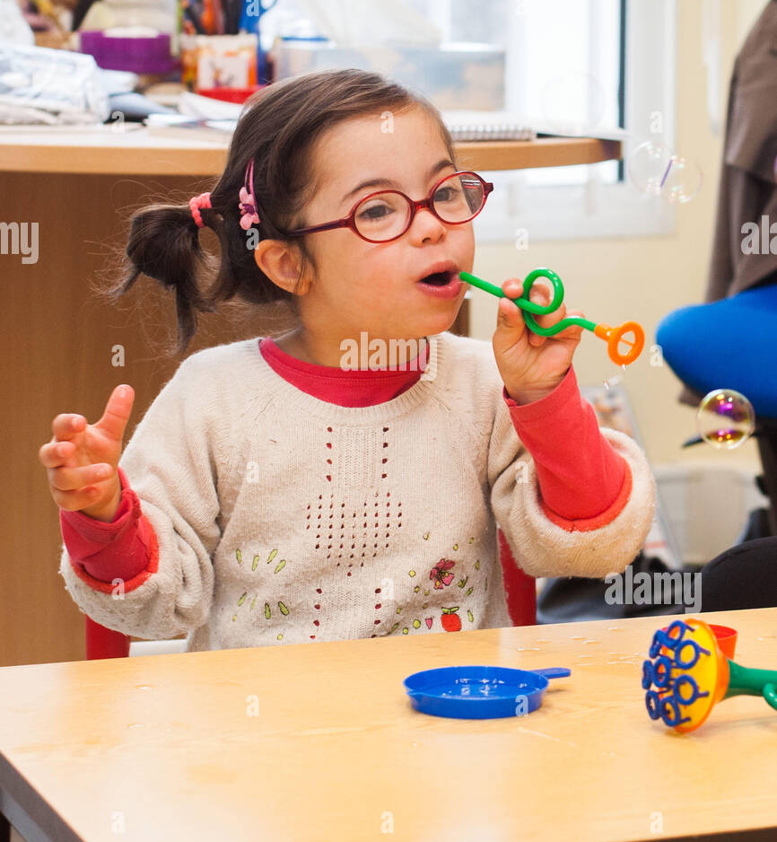
Background
Crucial for effective communication, especially for children with Down syndrome
01
02
Distinct physical features (small nose, upward-slanting eyes) and cognitive delays [11]
The core challenges are delayed speech and limited vocabulary [12]
03
04
Suffer from speech disorders [13]
IT21293030 | Jayasuriya S.H. | 24-25J-228

Slide 37
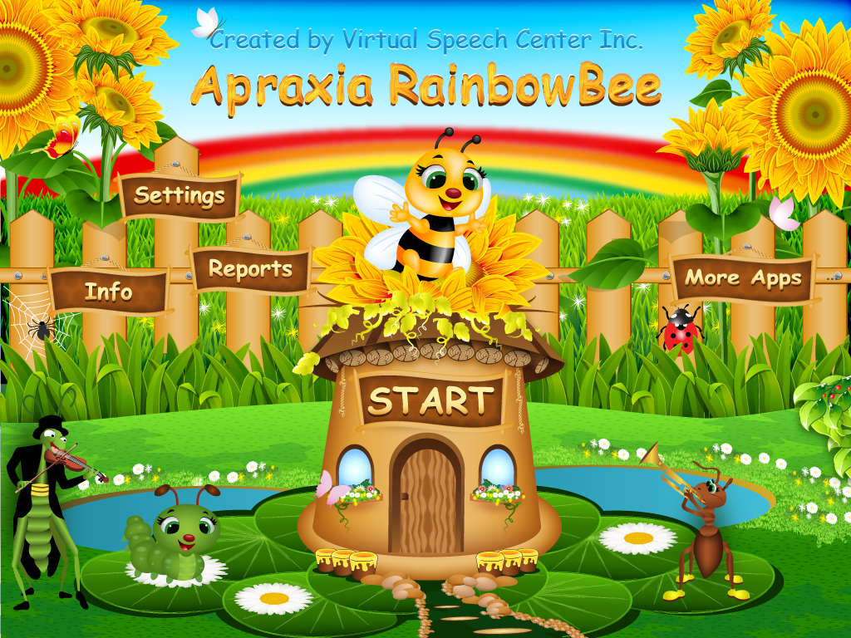
05
Traditional involves repetitive practice; modern uses interactive apps [14]
These five apps—Apraxia Rainbow Bee, Auditory Workout, Articulation Games, Phonological Processes App, and The Fun with R—are designed to enhance pronunciation skills
Covers phoneme articulation and auditory processing to benefit children with various speech challenges [15]
06
07
7
IT21293030 | Jayasuriya S.H. | 24-25J-228

Slide 38
Research Gap
Features
[16]
[17]
[18]
[19]
Web Application
Real time emotion Analysis
Access the knowledge level
Emotional based pronunciation practice game
Child voice detection
Technologies (CNN, NLP , OpenCV)
Features
[16] June 1993,” Developing the speech and language skills of teenagers with Down syndrome’’
[17]January 2020, “Design of a Mobile Application for the Learning of People with Down Syndrome through Interactive Games
[18] 2017, “Mobile Speech Therapy Application Using Speech Processing for Intellectually Disabled”
[15] 2007” Teaching Children with Down Syndrome Pronunciations Using Speech Recognition”
IT21293030 | Jayasuriya S.H. | 24-25J-228

Slide 39
Research Question
How can a web application utilizing sentiment analysis, motivational messaging, and deep learning techniques for monitoring and analyzing motor skills improve pronunciation accuracy and emotional well-being in children with down syndrome?
IT21293030 | Jayasuriya S.H. | 24-25J-228

Slide 40
01
Use advanced computer vision to create emotional base pronunciation practice game
Specific Objectives
02
Real-time tracking algorithms to measure shape, speed, and phonetic accuracy.
To enhance the pronunciation for children with Down syndrome via a user-friendly web application.
03
Offer immediate visual and auditory feedback to correct pronunciation.
04
Detect emotions with facial recognition to adjust feedback and keep children engaged.
05
Design interactive tools and exercises for everyday vocabulary practices.
IT21293030 | Jayasuriya S.H. | 24-25J-228

Slide 41
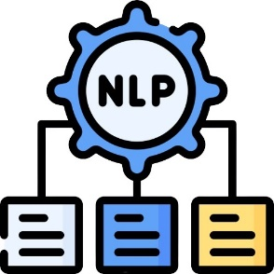

Technologies
Natural language processing (NLP)
Convolutional Neural Network (CNN)
TensorFlow
React
Python
OPENCV
IT21293030 | Jayasuriya S.H. | 24-25J-228

Slide 42
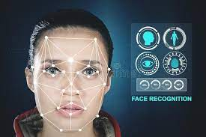
Key Pillars
Image
Processing
Convolutional Neural Network (CNN)
Machine
Learning
Voice
Detection
IT21293030 | Jayasuriya S.H. | 24-25J-228

Slide 43
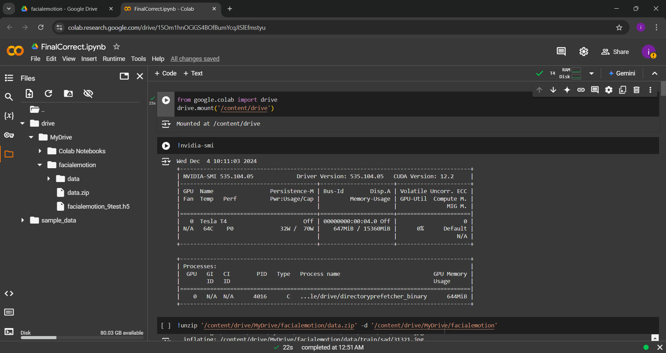
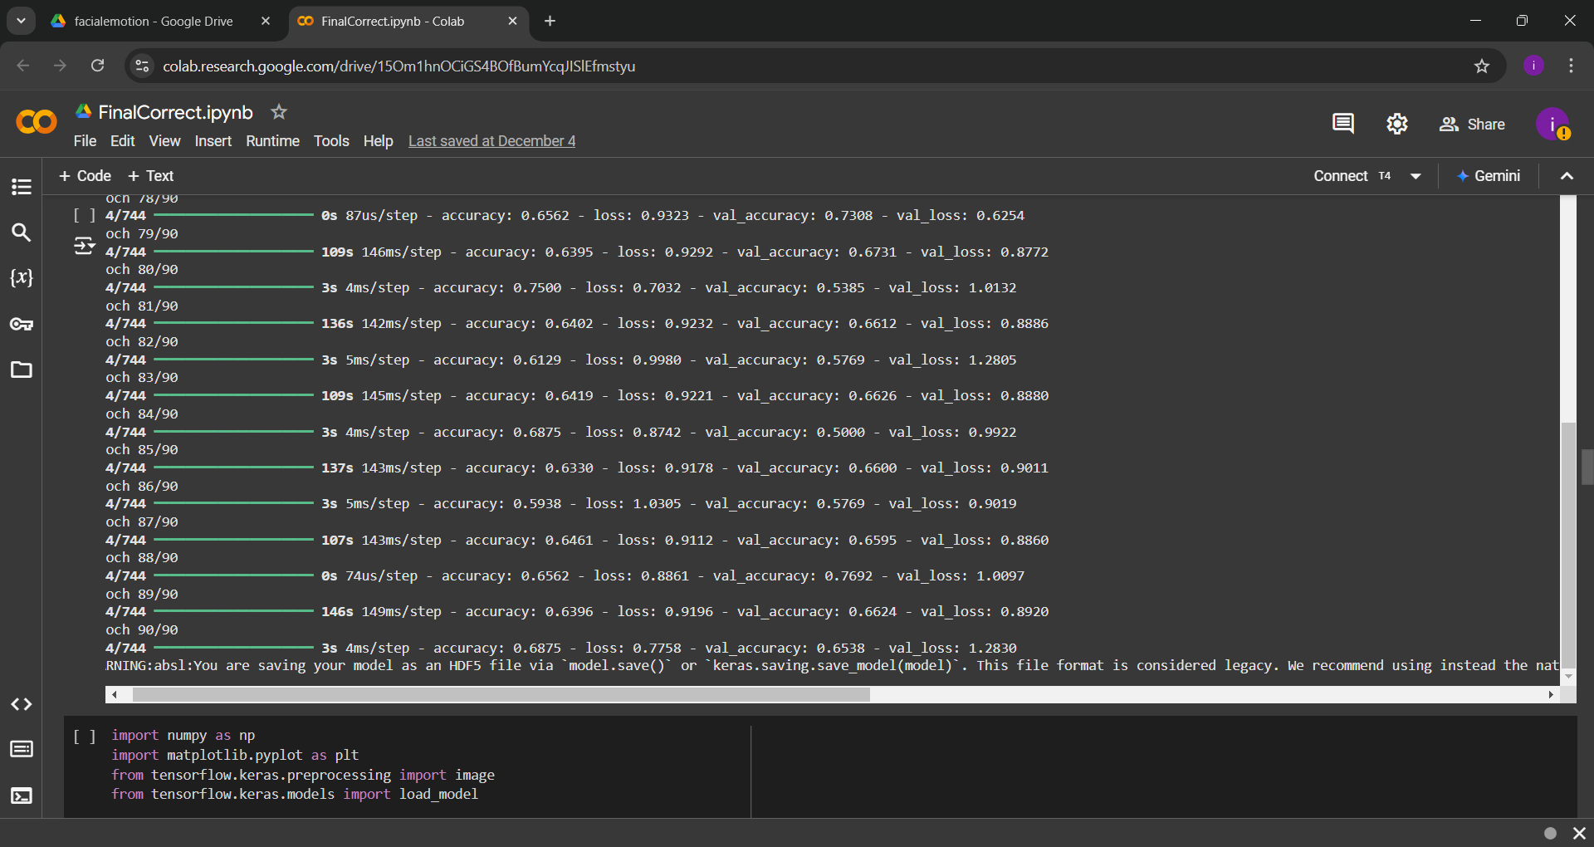
Proof of Concept
Gather the train and test datasets and using Google Colab to train the dataset.
IT21293030 | Jayasuriya S.H. | 24-25J-228

Slide 44
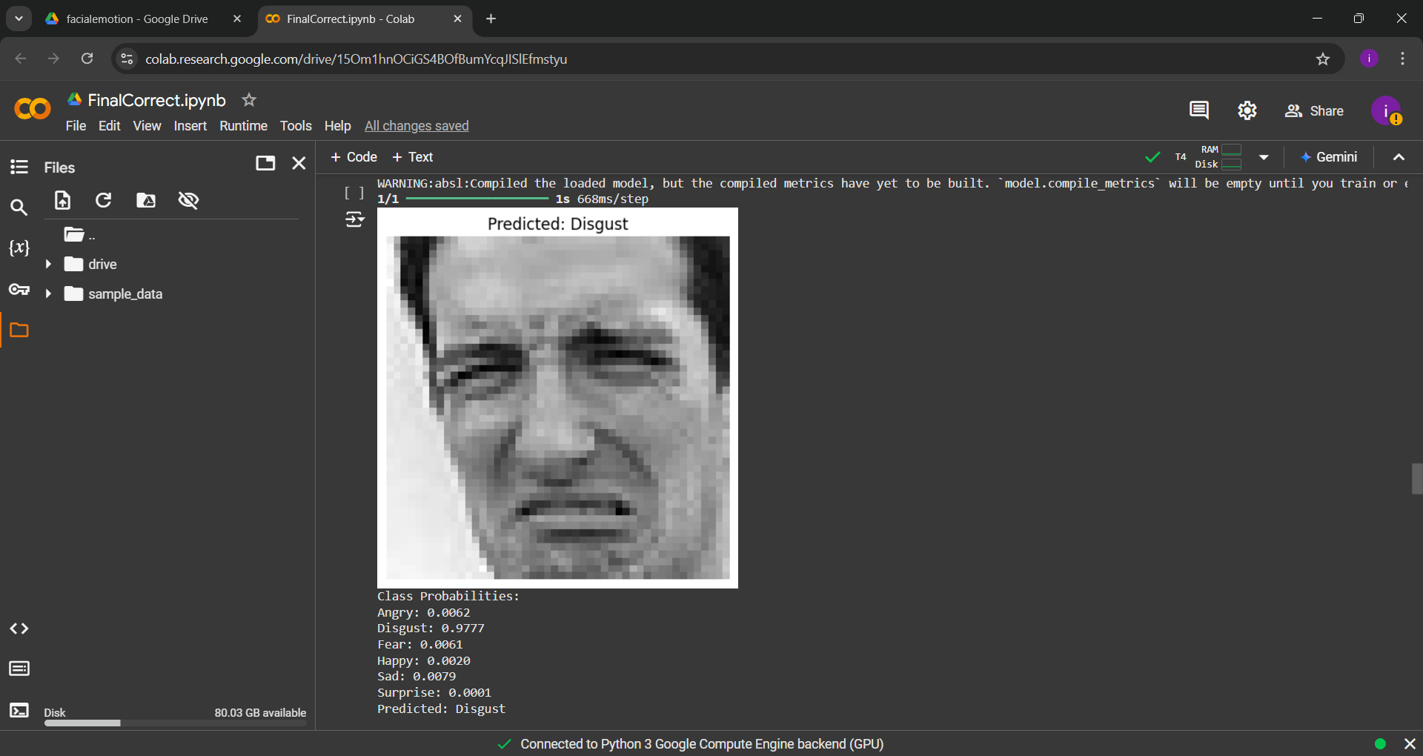
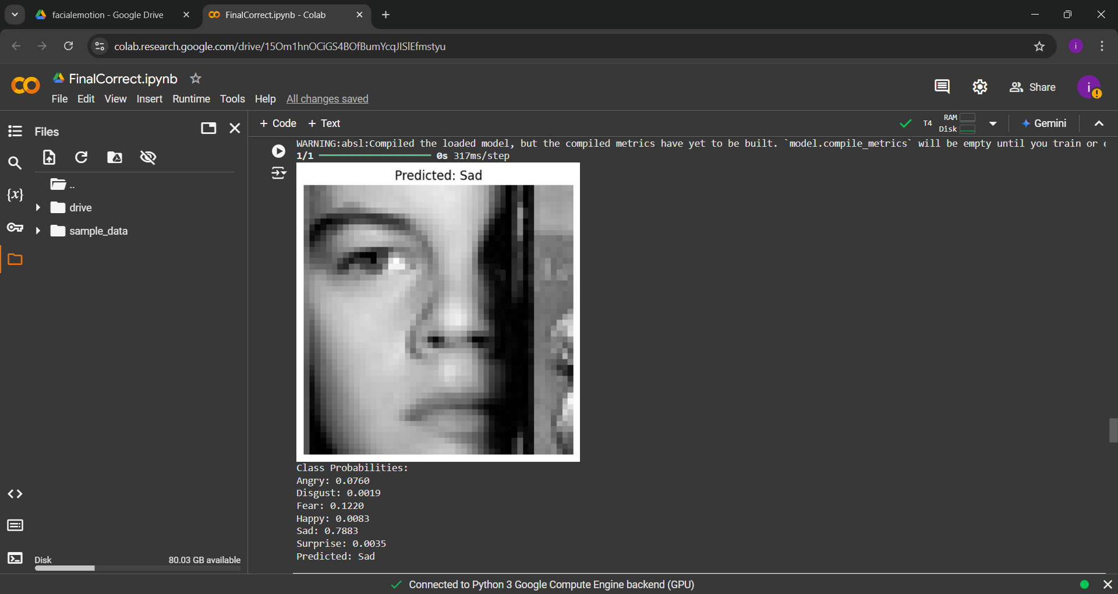
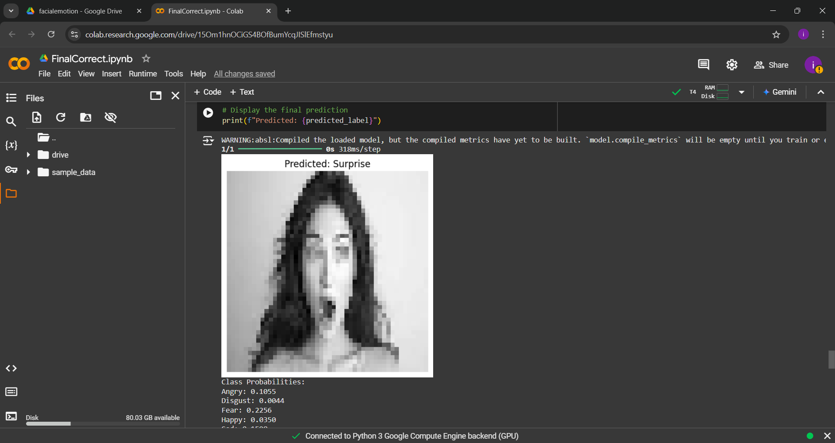
Proof of Concept
tested the model ,it could accurately detect emotions and checked the probabilities. .
IT21293030 | Jayasuriya S.H. | 24-25J-228

Slide 45
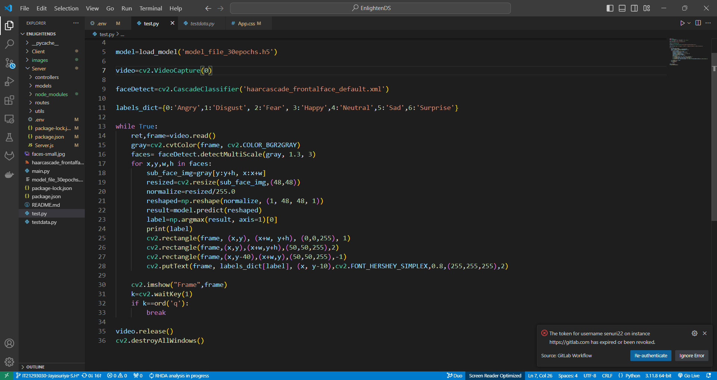
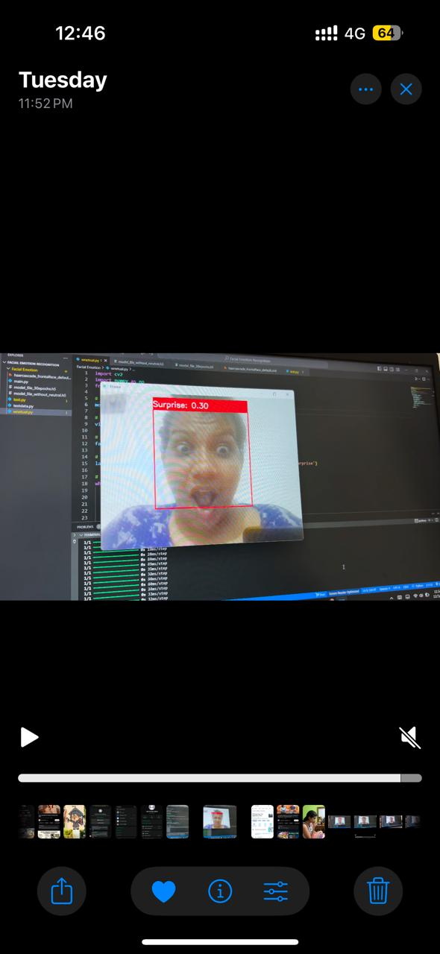
Proof of Concept
Use the test.py code to run and detect real-time facial expressions of individuals.​
IT21293030 | Jayasuriya S.H. | 24-25J-228

Slide 46
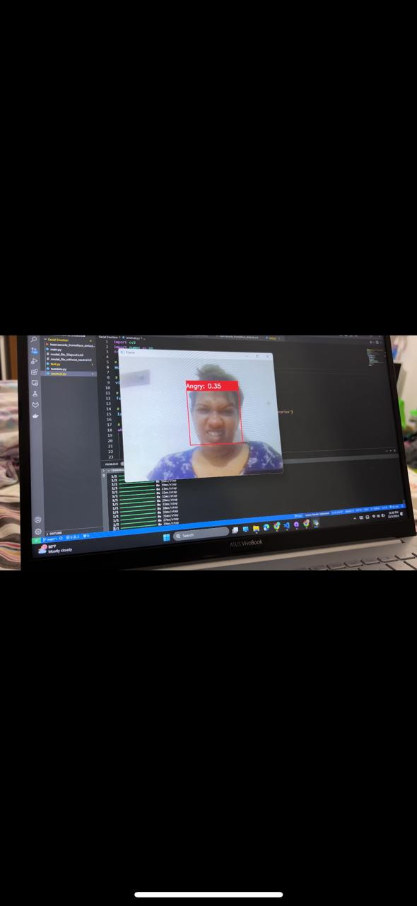
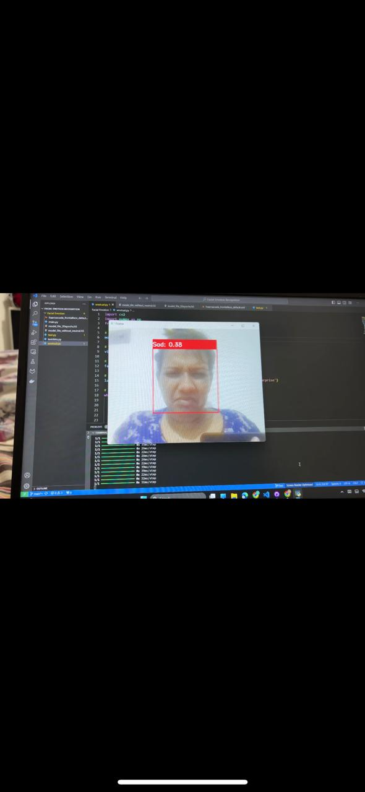

Proof of Concept
IT21293030 | Jayasuriya S.H. | 24-25J-228

Slide 47


Proof of Concept
Python backend logic
React frontend logic
IT21293030 | Jayasuriya S.H. | 24-25J-228

Slide 48


Proof of Concept
IT21293030 | Jayasuriya S.H. | 24-25J-228

Slide 49


Proof of Concept
Provide feedback based on the correctness of the pronunciation.​
Allow users to click on an image to hear the pronunciation of the displayed word. ​
Detect the child’s voice and convert it to text.
Check if the converted text is correct.
IT21293030 | Jayasuriya S.H. | 24-25J-228

Slide 50

Completion
Gathered a diverse dataset of images from children with Down syndrome
Trained the model
60%
Offer immediate visual and auditory feedback
to correct pronunciation. (Sub-Objectives 01)
Detect emotions with facial recognition.to adjust feedback and keep children engaged. (Sub-Objectives 02)
Design interactive tools and exercises for everyday vocabulary practices. (Sub-Objectives 03)
IT21293030 | Jayasuriya S.H. | 24-25J-228 50

Slide 51

System Diagram
IT21293030 | Jayasuriya S.H. | 24-25J-228

Slide 52

Functional & Non-functional Requirements
Functional Requirements
Non-Functional Requirements
Accurately recognize and assess pronunciation.
Provide immediate visual and auditory feedback on pronunciation.
Analyze facial expressions and mouth movements.
Include interactive gamified quizzes to engage the child and make learning enjoyable.
Availability
Reliability
User friendly
High performance
IT21293030 | Jayasuriya S.H. | 24-25J-228

Slide 53
Gantt Chart
IT21293030 Jayasuriya S.H. 25J-228
IT21293030 | Jayasuriya S.H. | 24-25J-228

Slide 54
Work Breakdown Chart
IT21293030 Jayasuriya S.H. 25J-228
IT21293030 | Jayasuriya S.H. | 24-25J-228

Slide 55
References
[11] “Epidemiology of Down syndrome - Sherman - 2007 - Mental Retardation and Developmental Disabilities Research Reviews - Wiley Online Library.” Accessed: Aug. 11, 2024. [Online]. Available: https://onlinelibrary.wiley.com/doi/10.1002/mrdd.20157
[12] “Down’s syndrome - ScienceDirect.” Accessed: Aug. 11, 2024. [Online]. Available: https://www.sciencedirect.com/science/article/abs/pii/S014067360312987X
[13] J. E. Roberts, J. Price, and C. Malkin, “Language and communication development in down syndrome,” Mental Retardation and Developmental Disabilities Research Reviews, vol. 13, no. 1, pp. 26–35, 2007, doi: 10.1002/mrdd.20136.
[14] A. Wołowicz-Ruszkowska and D. McConnell, “The experience of adult children of mothers with intellectual disability: A qualitative retrospective study from Poland,” Journal of Applied Research in Intellectual Disabilities, vol. 30, no. 3, pp. 482–491, 2017, doi: 10.1111/jar.12322.
[15] “Ethnic differences in the link between physical discipline and later adolescent externalizing behaviors - Lansford - 2004 - Journal of Child Psychology and Psychiatry - Wiley Online Library.” Accessed: Aug. 11, 2024. [Online]. Available: https://acamh.onlinelibrary.wiley.com/doi/10.1111/j.1469-7610.2004.00273.x
IT21293030 | Jayasuriya S.H. | 24-25J-228

Slide 56
References
[16] Sue Buckley, June 1993,” Developing the speech and language skills of teenagers with Down syndrome’’ https://www.researchgate.net/publication/243131885_Developing_the_speech_and_language_skills_of_teenagers_with_Down_syndrome
[17] Richard Arias-Marreros, Keyla Nalvarte-Dionisio, Laberiano Andrade-Arenas, January 2020, “Design of a Mobile Application for the Learning of People with Down Syndrome through Interactive Games” https://www.researchgate.net/publication/347345266_Design_of_a_Mobile_Application_for_the_Learning_of_People_with_Down_Syndrome_through_Interactive_Games
[18] Fatemah Javadi, Rouhollah Dianat, Vol 11 No 4 (2017)“Mobile Speech Therapy Application Using Speech Processing for Intellectually Disabled”,
https://jmr.tums.ac.ir/index.php/jmr/article/view/133
[19] K. Patel and L. Wong, "Teaching Children with Down Syndrome Pronunciations Using Speech Recognition," in Proceedings of the 2007 IEEE International Conference on Advanced Learning Technologies (ICALT), Niigata, Japan, 2007, pp. 486-488. Available:https://www.researchgate.net/publication/206005894_Teaching_Children_with_Down_Syndrome_Pronunciations_Using_Speech_Recognition.
IT21293030 | Jayasuriya S.H. | 24-25J-228

Slide 57

IT21342394 | Semini B.V.S.
Specialization : Information Technology
Enhancing mathematical skills in children with Down Syndrome
IT21342394 | Semini B.V.S. | 24-25J-228
IT21293030 Jayasuriya S.H. 25J-228

Slide 58

Background
Children with Down Syndrome generally struggle with arithmetic skills
01
02
Numerical skills in these individuals are delayed by two years compared in literacy [20]
03
Teaching methods for numeracy
Kumon Method:
Breaking down learning into small steps.
Stern and Numicon Method:
Uses concrete materials to understand numbers [22]
IT21342394 | Semini B.V.S. | 24-25J-228

Slide 59

Basic skills like number recognition and counting
Introduce more numbers and difficulty levels
Progress tracking
Simple additions, subtraction, multiplication and division using small numbers(0-10)
Quiz creations
IT21342394 | Semini B.V.S. | 24-25J-228

Slide 60
Research Gap
Features
[23]
[24]
[25]
[26]
Creating adaptive questioner
Divided questions into difficulty levels
Focus on improving basic numerical skills
Educational animation integration for explanations
Quiz creation
Get overall statistics of performance
Features
[23] January 2021,” Training basic numerical skills in children with Down syndrome using the computerized game “The Number Race”
[24] February 2015, “Mathematics interventions for children and adolescents with Down syndrome: A research synthesis”
[25] 2017, “Comparison of Mathematics Performance of Children and Adolescents with and without Down Syndrome”
[26] December 2016, “The foundations of mathematical development in Williams syndrome and Down syndrome”
IT21342394 | Semini B.V.S. | 24-25J-228

Slide 61

Research Question
How can adaptive learning technologies be effectively utilized to support the development of foundational arithmetic skills in children with down syndrome, considering the unique challenges they face in numerical skill acquisition?
IT21342394 | Semini B.V.S. | 24-25J-228

Slide 62
01
Design adaptive quizzes that adjust difficulty based on real-time performance
Specific Objectives
02
Integrate educational animations with step-by-step solutions
Develop an adaptive learning system tailored to the educational needs of children with Down syndrome
03
Create a performance tracking module that logs progress and generates detailed reports
04
Evaluate improvements in mathematical skills through post-system quizzes
05
Develop a user-friendly interface
IT21342394 | Semini B.V.S. | 24-25J-228

Slide 63


Proof of Concept
Dynamic Question Generator Backend Logic
IT21342394 | Semini B.V.S. | 24-25J-228

Slide 64


Proof of Concept
User Interfaces
IT21342394 | Semini B.V.S. | 24-25J-228

Slide 65



Proof of Concept
IT21342394 | Semini B.V.S. | 24-25J-228

Slide 66




Proof of Concept
IT21342394 | Semini B.V.S. | 24-25J-228

Slide 67


Proof of Concept
Train a model to determine whether the child is ready to progress to the next difficulty level
IT21342394 | Semini B.V.S. | 24-25J-228

Slide 68





Proof of Concept
IT21342394 | Semini B.V.S. | 24-25J-228

Slide 69


Proof of Concept
IT21342394 | Semini B.V.S. | 24-25J-228

Slide 70




Proof of Concept
Test the trained model
IT21342394 | Semini B.V.S. | 24-25J-228

Slide 71




Proof of Concept
IT21342394 | Semini B.V.S. | 24-25J-228

Slide 72
Completion
Create 4 categories of question pools
Addition
Subtraction
Multiplication
Division
Create three difficulty levels, each with four sub-levels.
The difficulty of the sub-level questions are adjust based on the child's performance
Design quizzes for all levels
Collect data and generate a dataset.
Train a model to determine whether the child is ready to progress to the next difficulty level.
60%
04
IT21342394 | Semini B.V.S. | 24-25J-228 72

Slide 73

System Diagram
IT21342394 | Semini B.V.S. | 24-25J-228

Slide 74


Technologies
Natural language processing (NLP)
TensorFlow
Animaker
React
Python
JavaScript libraries
IT21342394 | Semini B.V.S. | 24-25J-228

Slide 75

Key Pillars
Natural
language processing
Data Preprocessing
Machine
Learning
Gamified Activities
IT21342394 | Semini B.V.S. | 24-25J-228

Slide 76

Functional & Non-functional Requirements
Functional Requirements
Non-Functional Requirements
Provide quizzes that adjust difficulty based on performance
Include animations that explain concepts step-by-step
Ensure an easy-to-use interface with visual and audio
Track user progress and generate detailed reports
Support multiple users without performance loss.
Make the interface easy to use for all abilities.
Ensure reports accurately reflect user performance metrics.
Design reports to be easy to read and understand.
IT21342394 | Semini B.V.S. | 24-25J-228

Slide 77
Gantt Chart
IT21293030 Jayasuriya S.H. 25J-228
IT21342394 | Semini B.V.S. | 24-25J-228

Slide 78
Work Breakdown Chart
IT21293030 Jayasuriya S.H. 25J-228
IT21342394 | Semini B.V.S. | 24-25J-228

Slide 79
References
[20] (2006 Jun,” A comparison of mainstream and special education for teenagers with Down syndrome: implications for parents and teachers” https://pubmed.ncbi.nlm.nih.gov/16869376/ )
[21] 2006,”Learning about number and math”,https://www.down-syndrome.org/en-gb/library/news-update/06/1/learning-number-maths/
[22] Learn at Home Activities for Math”, https://www.dsrf.org/resources/learn-at-home/learn-at-home-activities-for-math/
[23] Francesco Sella, Sara Onnivello, Maristella Lunardon, Silvia Lanfranchi & Marco Zorzi , January 2021,” Training basic numerical skills in children with Down syndrome using the computerized game “The Number Race” https://www.nature.com/articles/s41598-020-78801-5
[24] C J Lemons, Sarah R Powell, Seth King, February 2015, “Mathematics interventions for children and adolescents with Down syndrome: A research synthesis” https://www.researchgate.net/publication/272744270_Mathematics_interventions_for_children_and_adolescents_with_Down_syndrome_A_research_synthesis
IT21342394 | Semini B.V.S. | 24-25J-228

Slide 80
References
[25] C J Lemons, Sarah R Powell, Seth King,Jan 2017, “Comparison of Mathematics Performance of Children and Adolescents with and without Down Syndrome”,
https://www.researchgate.net/profile/Seth-King-7/publication/316940866_Comparison_of_Mathematics_Performance_of_Children_and_Adolescents_with_and_without_Down_Syndrome/links/591a21b70f7e9b1db652973b/Comparison-of-Mathematics-Performance-of-Children-and-Adolescents-with-and-without-Down-Syndrome.pdf
[26] Jo Van Herwegen, PhD1 Erica Ranzato1 Annette Karmiloff-Smith, PhD Victoria Simms, December 2016, “The foundations of mathematical development in Williams syndrome and Down syndrome” https://discovery.ucl.ac.uk/id/eprint/10096606/1/Van%20Herwegen_Mathematical%20development%20in%20Williams%20syndrome%20and%20Down%20syndrome%20accepted.pdf
IT21342394 | Semini B.V.S. | 24-25J-228

Slide 81

IT21292972 | Methsahani K.K.S.P
Specialization : Information Technology
Identify the interests and talents of children with down syndrome
IT21292972 | Methsahani K.K.S.P. | 24-25J-228
IT21293030 Jayasuriya S.H. 25J-228

Slide 82

Background
01
Implement a system to identify and nurture talents in children with Down syndrome.
02
Focus Areas: Recital skills, learning skills and painting skills.
Down syndrome children talented for one specific area. According to the previous research works there’s no proper system to identify that talent.[27][28][29]
03
04
Most research focuses on the challenges faced by children with Down syndrome[27].
IT21292972 | Methsahani K.K.S.P. | 24-25J-228

Slide 83
Research Gap
Features
[27]
[28]
[29]
[30]
[16]
[17]
Identify learning skill
Identify recital skill
Identify the talented area
Identify drawing skill
Generate quiz using AI
[27] Jan. 2015, “Need Analysis for Down Syndrome Children to Develop a Learning Material on Numbers with the Aid of Multimedia Technology,”
[28] 2021, “Chapter Four - The emergence of fine motor skills in children with Down syndrome”
[29]2022, "E-Learning Education System For Children With Down Syndrome”
[30]2023, "Beyond Question Shuffling: Randomization Techniques in Programming Assessment"
IT21292972 | Methsahani K.K.S.P. | 24-25J-228

Slide 84
Research Question
Most of the time down syndrome children talented for one specific area. Identify that talented area is a little bit complex and difficult task. This component is to identify that talented area.
IT21292972 | Methsahani K.K.S.P. | 24-25J-228

Slide 85

01
Recital Skill Identification
Specific Objectives
02
Learning Skill Measurement
Integrate the different skill assessment components into a unified system that provides comprehensive insights into a child’s talents.
Improve their talented area.
03
Develop a user-friendly interface for children to easily access.
2
04
Painting Skill Evaluation
03
05
Analyze the collected data to identify the skill area with the highest engagement and proficiency for each child.
04
06
Highlighting their child’s strengths and potential areas for further development.
IT21292972 | Methsahani K.K.S.P. | 24-25J-228

Slide 86

Technologies
Artificial Intelligent
(AI)
Python
libraries
React
JavaScript libraries
IT21292972 | Methsahani K.K.S.P. | 24-25J-228

Slide 87

Key Pillars
Artificial Intelligent
(AI)
Machine
Learning
Image
Processing
IT21292972 | Methsahani K.K.S.P. | 24-25J-228

Slide 88


Proof of Concepts
Code level implementation and Main category selection interface
IT21292972 | Methsahani K.K.S.P. | 24-25J-228

Slide 89


Proof of Concepts
Graphical User Interfaces
IT21292972 | Methsahani K.K.S.P. | 24-25J-228

Slide 90


Proof of Concepts
Interfaces of quiz generation using AI
IT21292972 | Methsahani K.K.S.P. | 24-25J-228

Slide 91


Proof of Concepts
GUI of quiz completion page
Drawing platform interface
IT21292972 | Methsahani K.K.S.P. | 24-25J-228

Slide 92
Completion
Gathered a diverse dataset of images from children with Down syndrome
Implemented a code to generate quizzes using AI according to the user selected category
Implemented the painting platform
60%
Implemented the piano simulation
IT21292972 | Methsahani K.K.S.P. | 24-25J-228

Slide 93

System Diagram
IT21292972 | Methsahani K.K.S.P. | 24-25J-228

Slide 94


Functional & Non-functional Requirements
Functional Requirements
Non-Functional Requirements
Ability to select categories.
Quiz generation.
Data Analysis according to the user inputs.
Send notification to parent.
Performance
Reliability
Usability
Maintainability
IT21292972 | Methsahani K.K.S.P. | 24-25J-228

Slide 95
Gantt Chart
IT21293030 Jayasuriya S.H. 25J-228
IT21292972 | Methsahani K.K.S.P. | 24-25J-228

Slide 96
Work Breakdown Chart
IT21293030 Jayasuriya S.H. 25J-228
IT21292972 | Methsahani K.K.S.P. | 24-25J-228

Slide 97
References
[28] J. Janier, A. Shafie, M. Taha, N. Mohamad, W. F. Wan Ahmad, and R. Lob Yussof, “Need Analysis for Down Syndrome Children to Develop a Learning Material on Numbers with the Aid of Multimedia Technology,” International Journal of Social Science and Humanity, vol. 5, pp. 107–111, Jan. 2015, doi: 10.7763/IJSSH.2015.V5.433.
[29] A. W. Needham, E. L. Nelson, A. D. Short, L. A. Daunhauer, and D. J. Fidler, “Chapter Four - The emergence of fine motor skills in children with Down syndrome,” inInternational Review of Research in Developmental Disabilities, vol. 60, R. M. Hodapp and D. J. Fidler, Eds., Academic Press, 2021, pp. 113–151. doi: 10.1016/bs.irrdd.2021.08.002.
[30] A. S. T. Sampath, M. W. Vidanapathirana, T. B. A. Gunawardana, P. W. H. Sandeepani, L. H. S. S. Chandrasiri, and B. Attanayaka, “E-Learning Education System For Children With Down Syndrome,” in 2022 IEEE 10th Region 10 Humanitarian Technology Conference (R10-HTC), Sep. 2022, pp. 450–455. doi: 10.1109/R10-HTC54060.2022.9929446.
[31] H. Hickman, P. McKeown, and T. Bell, “Beyond Question Shuffling: Randomization Techniques in Programming Assessment,” in 2023 IEEE Frontiers in Education Conference (FIE), Oct. 2023, pp. 1–9. doi: 10.1109/FIE58773.2023.10342976.
IT21292972 | Methsahani K.K.S.P. | 24-25J-228

Slide 98
THANK YOU!

